Slide 1
Bringing Structure to Text
Jiawei Han, Chi Wang and Ahmed El-Kishky
Computer Science, University of Illinois at Urbana-Champaign
August 24, 2014

Slide 2
Outline
Introduction to bringing structure to text
Mining phrase-based and entity-enriched topical hierarchies
Heterogeneous information network construction and mining
Trends and research problems

Slide 3
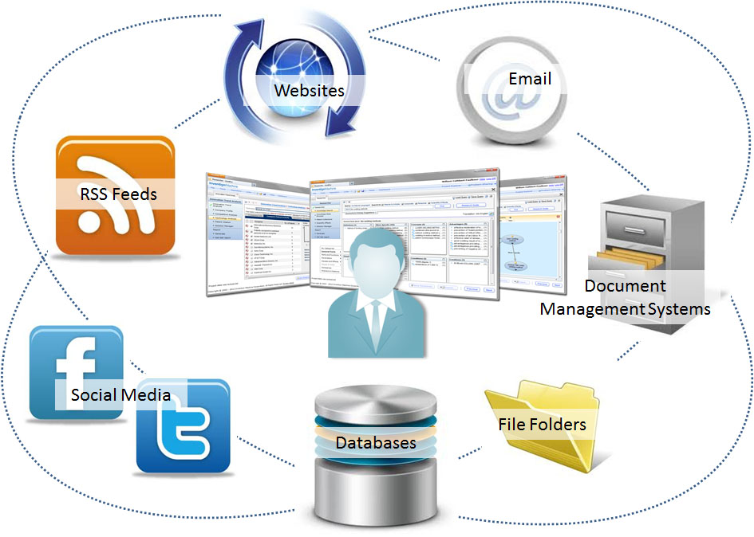
Motivation of Bringing Structure to Text
The prevalence of unstructured data
Structures are useful for knowledge discovery
Too expensive to be structured by human: Automated & scalable
Up to 85% of all information is unstructured
-- estimated by industry analysts
Vast majority of the CEOs expressed frustration over their organization’s inability to glean insights from available data
-- IBM study with1500+ CEOs

Slide 4
Information Overload:
A Critical Problem in Big Data Era
By 2020, information will double every 73 days
-- G. Starkweather (Microsoft), 1992
Unstructured or loosely structured data are prevalent
Information growth
Notes:
people are overloaded with unstructured, or loosely structured information

Slide 5

Example: Research Publications
Every year, hundreds of thousands papers are published
  Unstructured data: paper text
  Loosely structured entities: authors, venues
venue
papers
author

Slide 6


Example: News Articles
Every day, >90,000 news articles are produced
  Unstructured data: news content
  Extracted entities: persons, locations, organizations, …
organization
location
news
person

Slide 7







Example: Social Media
Every second, >150K tweets are sent out
  Unstructured data: tweet content
  Loosely structured entities: twitters, hashtags, URLs, …
#maythefourthbewithyou
hashtag
twitter
Darth Vader
tweets
URL
The White House

Slide 8
Text-Attached Information Network for
Unstructured and Loosely-Structured Data
organization
venue
location
hashtag
twitter
papers
news
tweets
person
URL
author
text
entity (given or extracted)
Notes:
This text plus linked entities is a pretty common way to organize information in many different domains. And we give this data model a name: information network
For example, research publications contain valuable scientific knowledge. News articles and social media contain information about people’s daily lives. These data are loosely structured because the information is stored in plain text, plus a little extra information. The most typical extra info is the links with entities. A research paper is linked to authors and venues. News articles have links to named entities like people and locations – although the links may be latent before we identify the named entities.
Why do I care about these data? Number 1: they contain huge amount of knowledge that is missing in a knowledgebase. Number 2: this text + link format is very common
If we can find the hidden structure in these data, we can better organize them and make it easy for people to acquire knowledge from them
Only a very small fraction of common knowledge can be found in Wikipedia.
Even for the celebrities, like Obama, the loosely structured news articles and social media contain much richer information than what exists in a knowledgebase.
Tweets + hashtag/URL/twitter
Enterprise logs + product/review/customer
Medical records + disease/treatment/doctor
Webpages + URL
Knowledge missing in a knowledgebase, but not in a well structured form

Slide 9
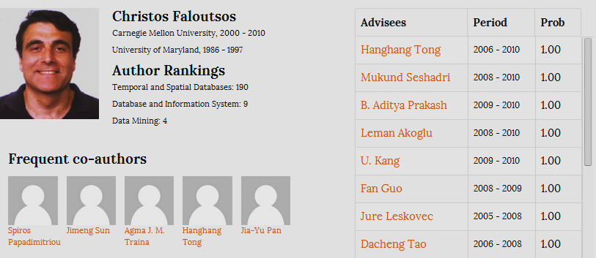
What Power Can We Gain if More Structures Can Be Discovered?
Structured database queries
Information network analysis, …

Slide 10
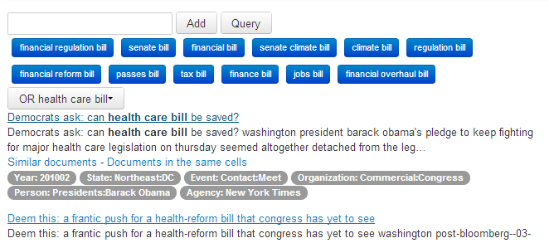

Structures Facilitate Multi-Dimensional Analysis: An EventCube Experiment

Slide 11
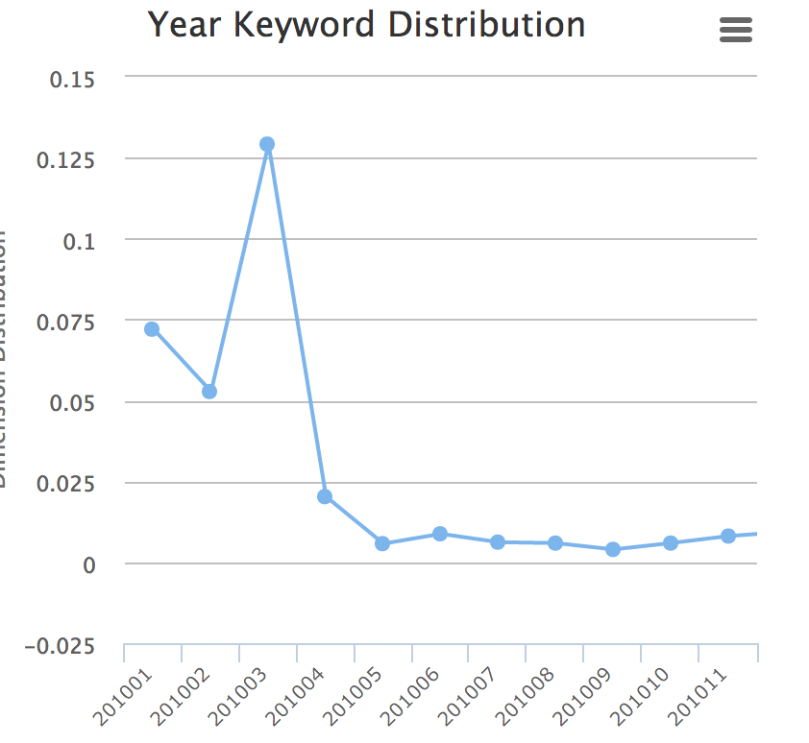
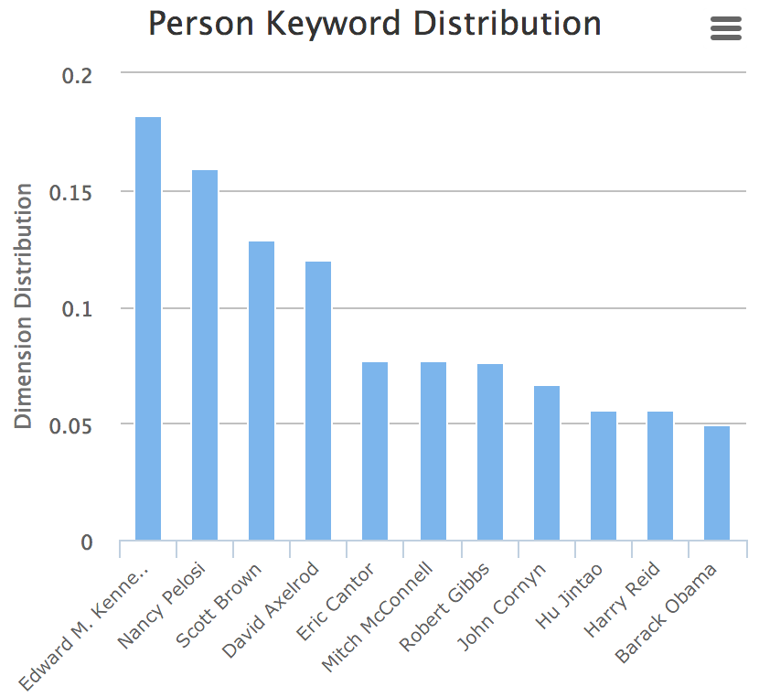
Distribution along Multiple Dimensions
Query ‘health care bill’ in news data

Slide 12
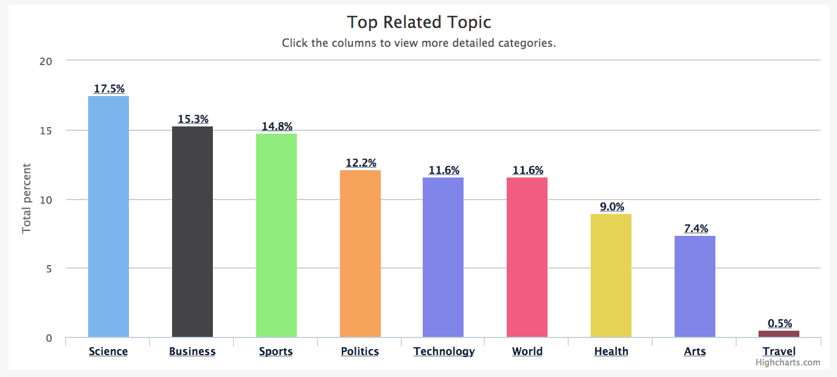
Entity Analysis and Profiling
Topic distribution for “Stanford University”

Slide 13
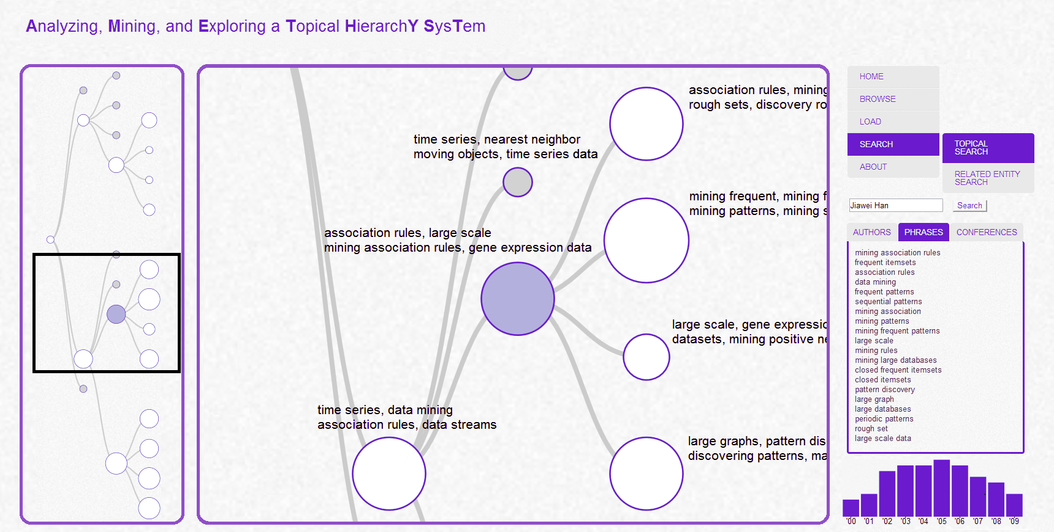

Slide 14
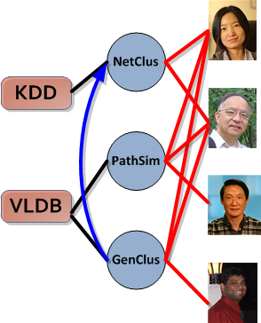
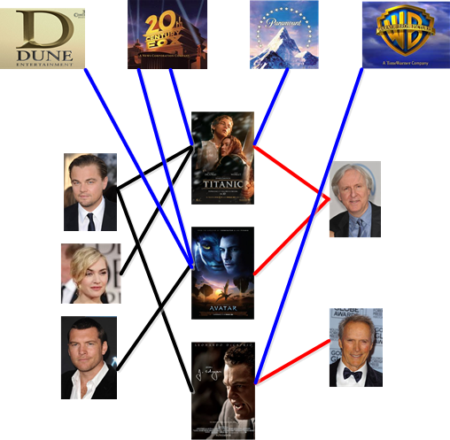
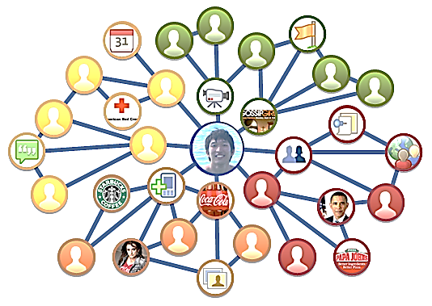
Structures Facilitate Heterogeneous Information Network Analysis
Real-world data: Multiple object types and/or multiple link types
Movie
Studio
Venue
Paper
Author
Actor
Director
Movie
DBLP Bibliographic Network
The IMDB Movie Network
The Facebook Network

Slide 15

What Can Be Mined in Structured Information Networks
Example: DBLP: A Computer Science bibliographic database
Knowledge hidden in DBLP Network | Mining Functions
Who are the leading researchers on Web search? | Ranking
Who are the peer researchers of Jure Leskovec? | Similarity Search
Whom will Christos Faloutsos collaborate with? | Relationship Prediction
Which types of relationships are most influential for an author to decide her topics? | Relation Strength Learning
How was the field of Data Mining emerged or evolving? | Network Evolution
Which authors are rather different from his/her peers in IR? | Outlier/anomaly detection

Slide 16
Useful Structure from Text:
Phrases, Topics, Entities
Top 10 active politicians and phrases regarding healthcare issues?
Top 10 researchers and phrases in data mining and their specializations?
Topics (hierarchical)
entity
Entities
Phrases
text
Notes:
The goal of my study is to discover these latent structures. There are three kinds of latent structures that are important to answer people’s questions: topics, concepts and relations. Let’s look at some example.
These two questions involve both topics and concepts. Although these two terms look alike each other and they can both be used to group entities, I use them to refer to two different structures. I use concept to refer to ‘is-a’ relationship between an entity and its concept category.
Latent
Interdisciplinary research groups in UW Seattle?
Most relevant organizations with NSA?

Slide 17
Outline
Introduction to bringing structure to text
Mining phrase-based and entity-enriched topical hierarchies
Heterogeneous information network construction and mining
Trends and research problems

Slide 18
Topic Hierarchy: Summarize the Data with Multiple Granularity
venue
Computer Science
Information technology & system
Database
Theory of computation
…
…
…
Information retrieval
…
…
Top 10 researchers in data mining?
  And their specializations?
Important research areas in SIGIR conference?
papers
author
Notes:
And provide context for all analyses
Why is it important? As I showed you in the examples, a lot of questions are related to topical structure of a dataset, and we often need to answer these questions in different granularity. If you ask me what are important research areas in SIGIR conference, my answer can be information retrieval. But that’s not good enough, right?
We want to organize the topics in different granularity to help answer questions related to topics: e.g.
The topic hierarchy is useful for Summarization, Browsing, Search
Not only a researcher can discover relevant work and subtopics to focus on, but also a student can quickly learn a new domain’s topics
and an data analyst can easily see the main topics of an arbitrary collection of e.g., news, business logs, or government reports

Slide 19
Methodologies of Topic Mining
A. Traditional bag-of-words topic modeling
B. Extension of topic modeling
i) Flat -> hierarchical
ii) Unigrams -> phrases
iii) Text -> text + entity
C. An integrated framework

Slide 20
Methodologies of Topic Mining
A. Traditional bag-of-words topic modeling
B. Extension of topic modeling
i) Flat -> hierarchical
ii) Unigrams -> phrases
iii) Text -> text + entity
C. An integrated framework

Slide 21
Bag-of-Words Topic Modeling
Widely studied technique for text analysis
  Summarize themes/aspects
  Facilitate navigation/browsing
  Retrieve documents
  Segment documents
  Many other text mining tasks
Represent each document as a bag of words: all the words within a document are exchangeable
Probabilistic approach

Slide 22
Topic:
Multinomial Distribution over Words
A document is modeled as a sample of mixed topics
How can we discover these topic word distributions from a corpus?
Topic 1
government 0.3
response 0.2
...
[ Criticism of government response to the hurricane primarily consisted of criticism of its response to the approach of the storm and its aftermath, specifically in the delayed response ] to the [ flooding of New Orleans. … 80% of the 1.3 million residents of the greater New Orleans metropolitan area evacuated ] …[ Over seventy countries pledged monetary donations or other assistance]. …
Topic 2
city 0.2
new 0.1
orleans 0.05
...
…
donate 0.1
relief 0.05
help 0.02
...
Topic 3

Slide 23

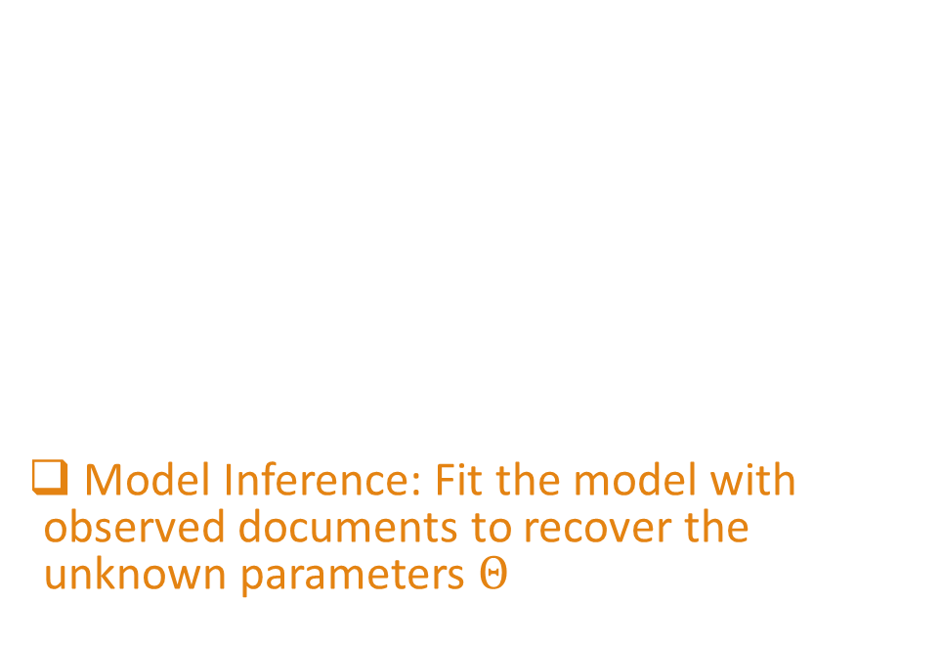
Routine of Generative Models
Model design: assume the documents are generated by a certain process
Model Inference: Fit the model with observed documents to recover the unknown parameters
corpus
Generative process with unknown parameters $Θ$
Criticism of government response to the hurricane …
Two representative models: pLSA and LDA

Slide 24
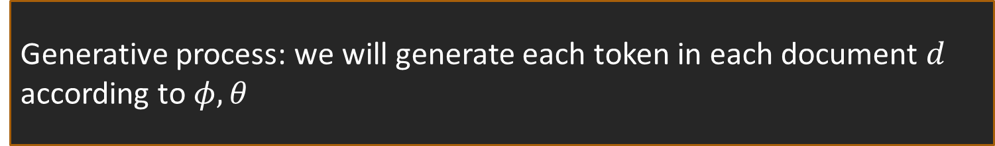


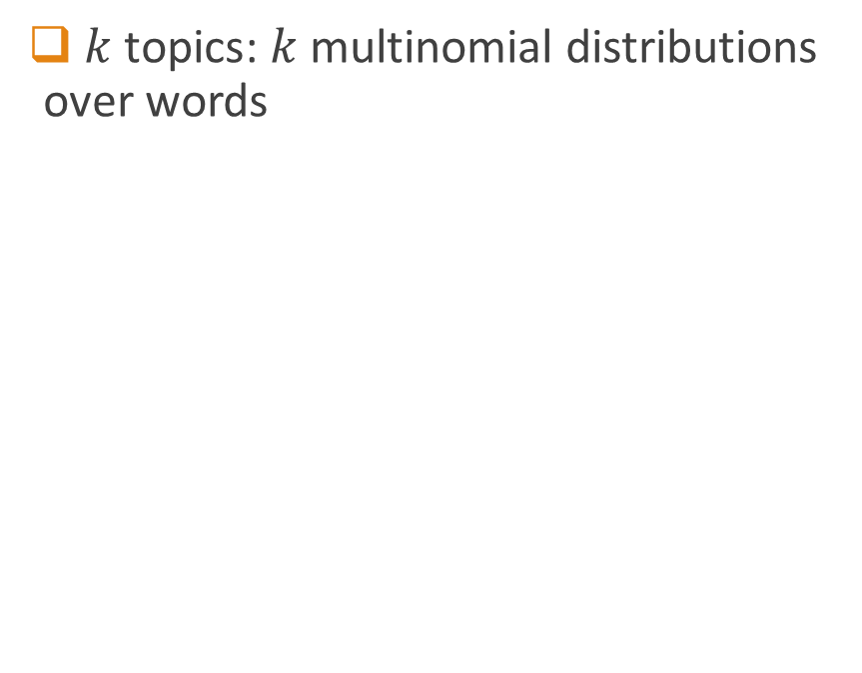



Probabilistic Latent Semantic Analysis (PLSA) [Hofmann 99]
$k$ topics: $k$ multinomial distributions over words
$D$ documents: $D$ multinomial distributions over topics
Topic $φ_{1}$
Topic $φ_{k}$
Doc $θ_{1}$
.4
.3
.3
…
government 0.3
response 0.2
...
donate 0.1
relief 0.05
...
…
Doc $θ_{D}$
.2
.5
.3
Generative process: we will generate each token in each document $d$ according to $φ,θ$

Slide 25
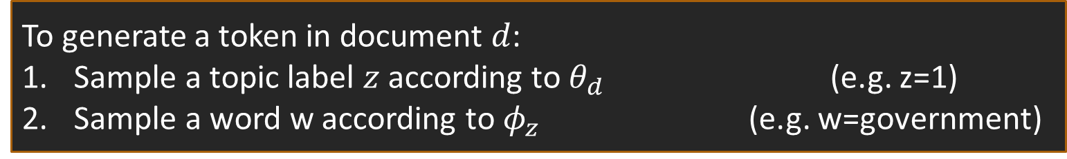


PLSA – Model Design
$k$ topics: $k$ multinomial distributions over words
$D$ documents: $D$ multinomial distributions over topics
Topic $φ_{1}$
Topic $φ_{k}$
Doc $θ_{1}$
.4
.3
.3
…
government 0.3
response 0.2
...
donate 0.1
relief 0.05
...
…
Doc $θ_{D}$
.2
.5
.3
To generate a token in document $d$:
Sample a topic label $z$ according to $θ_{d}$ (e.g. z=1)
Sample a word w according to $φ_{z}$ (e.g. w=government)
.4
.3
.3
Topic $φ_{z}$

Slide 26


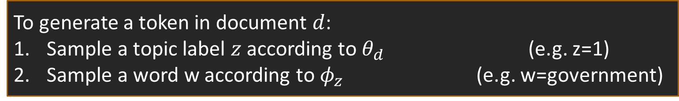



PLSA – Model Inference
Topic $φ_{1}$
Topic $φ_{k}$
corpus
…
government ?
response ?
...
donate ?
relief ?
...
Criticism of government response to the hurricane …
Doc $θ_{1}$
.?
.?
.?
…
What parameters are most likely to generate the observed corpus?
Doc $θ_{D}$
.?
.?
.?
To generate a token in document $d$:
Sample a topic label $z$ according to $θ_{d}$ (e.g. z=1)
Sample a word w according to $φ_{z}$ (e.g. w=government)
.4
.3
.3
Topic $φ_{z}$

Slide 27
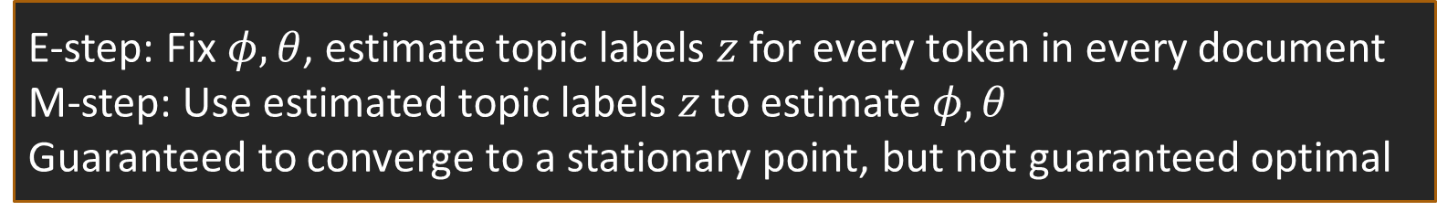
PLSA – Model Inference using Expectation-Maximization (EM)
Topic $φ_{1}$
Topic $φ_{k}$
corpus
…
government ?
response ?
...
donate ?
relief ?
...
Criticism of government response to the hurricane …
Doc $θ_{1}$
.?
.?
.?
…
Exact max likelihood is hard => approximate optimization with EM
Doc $θ_{D}$
.?
.?
.?
E-step: Fix $φ,θ$, estimate topic labels $z$ for every token in every document
M-step: Use estimated topic labels $z$ to estimate $φ,θ$
Guaranteed to converge to a stationary point, but not guaranteed optimal

Slide 28


How the EM Algorithm Works
Topic $φ_{1}$
Topic $φ_{k}$
response
…
d₁
criticism
government 0.3
response 0.2
...
donate 0.1
relief 0.05
...
government
…
Doc $θ_{1}$
.4
.3
.3
M-step
hurricane
d_{D}
Sum fractional counts
government
…
Doc $θ_{D}$
.2
.5
.3
response
E-step
Bayes rule

Slide 29
Analysis of pLSA
Pros
cons
Simple, only one hyperparameter k
Easy to incorporate prior in the EM algorithm
High model complexity -> prone to overfitting
The EM solution is neither optimal nor unique

Slide 30



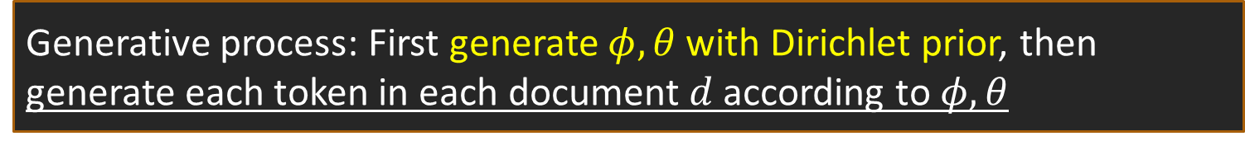



Latent Dirichlet Allocation (LDA)
[Blei et al. 02]
Impose Dirichlet prior to the model parameters -> Bayesian version of pLSA
$$β$$
Doc $θ_{1}$
.4
.3
.3
$$α$$
…
Topic $φ_{1}$
Topic $φ_{k}$
…
Doc $θ_{D}$
.2
.5
.3
government 0.3
response 0.2
...
donate 0.1
relief 0.05
...
To mitigate overfitting
Generative process: First generate $φ,θ$with Dirichlet prior, then generate each token in each document $d$ according to $φ,θ$
Same as pLSA

Slide 31
LDA – Model Inference
Maximum likelihood
Method of Moments
Aim to find parameters that maximize the likelihood
Exact inference is intractable
Approximate inference
  Variational EM [Blei et al. 03]
  Markov chain Monte Carlo (MCMC) – collapsed Gibbs sampler [Griffiths & Steyvers 04]
Aim to find parameters that fit the moments (expectation of patterns)
Exact inference is tractable
  Tensor orthogonal decomposition [Anandkumar et al. 12]
  Scalable tensor orthogonal decomposition [Wang et al. 14a]

Slide 32
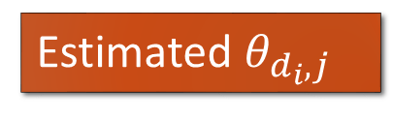



MCMC – Collapsed Gibbs Sampler [Griffiths & Steyvers 04]
response
d₁
criticism
…
Topic $φ_{1}$
Topic $φ_{k}$
government
…
government 0.3
response 0.2
...
donate 0.1
relief 0.05
...
…
d_{D}
hurricane
government
…
response
Estimated $φ_{j,w_{i}}$
Estimated $θ_{d_{i},j}$
Iter 1
Iter 2
…
Iter 1000
Sample each z_{i} conditioned on z_{-i}

Slide 33


Method of Moments
[Anandkumar et al. 12, Wang et al. 14a]
Topic $φ_{1}$
Topic $φ_{k}$
What parameters are most likely to generate the observed corpus?
corpus
…
government ?
response ?
...
donate ?
relief ?
...
Criticism of government response to the hurricane …
What parameters fit the empirical moments?
Moments: expectation of patterns
criticism: 0.03
response: 0.01
government: 0.04
:
criticism response: 0.001
criticism government: 0.002
government response: 0.003
:
criticism government response: 0.001
government response hurricane: 0.005
criticism response hurricane: 0.004
:
length 1
length 2 (pair)
length 3 (triple)

Slide 34

Guaranteed Topic Recovery
Theorem. The patterns up to length 3 are sufficient for topic recovery
$$M_{2}=\sum_{j=1}^{k}{λ_{j}φ_{j}⊗φ_{j}}, M_{3}=\sum_{j=1}^{k}{λ_{j}φ_{j}⊗φ_{j}⊗φ_{j}}$$
V
V
V
V
V
V: vocabulary size; k: topic number
criticism: 0.03
response: 0.01
government: 0.04
:
criticism response: 0.001
criticism government: 0.002
government response: 0.003
:
criticism government response: 0.001
government response hurricane: 0.005
criticism response hurricane: 0.004
:
length 1
length 2 (pair)
length 3 (triple)

Slide 35
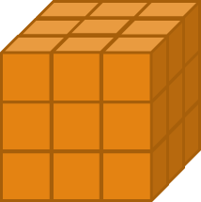





Tensor Orthogonal Decomposition for LDA
$$M_{2}$$
Topic $φ_{1}$
Input corpus
V
eigen decomposition
Normalized pattern counts
government 0.3
response 0.2
...
A: 0.03 | AB: 0.001 | ABC: 0.001
B: 0.01 | BC: 0.002 | ABD: 0.005
C: 0.04 | AC: 0.003 | BCD: 0.004
: | : | :
V
$$M_{3}$$
k
…
k
k
tensor product
$$\tilde{T }$$
Topic $φ_{k}$
V: vocabulary size
k: topic number
V
V
donate 0.1
relief 0.05
...
V

Slide 36
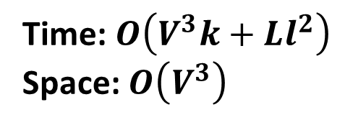

Tensor Orthogonal Decomposition for LDA – Not Scalable
$$M_{2}$$
Prohibitive to compute
Input corpus
Topic $φ_{1}$
V
Normalized pattern counts
government 0.3
response 0.2
...
A: 0.03 | AB: 0.001 | ABC: 0.001
B: 0.01 | BC: 0.002 | ABD: 0.005
C: 0.04 | AC: 0.003 | BCD: 0.004
: | : | :
V
$$M_{3}$$
k
…
k
k
Topic $φ_{k}$
$$\tilde{T }$$
V
donate 0.1
relief 0.05
...
V: vocabulary size; k: topic number
L: # tokens; l: average doc length
V
V
Time: $O\left(V^{3}k+Ll^{2}\right)$
Space: $O\left(V^{3}\right)$

Slide 37






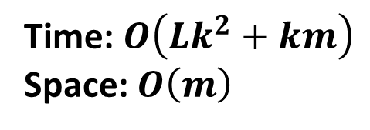
Scalable Tensor Orthogonal Decomposition
Input corpus
$$M_{2}$$
Topic $φ_{1}$
2nd scan
V
Normalized pattern counts
government 0.3
response 0.2
...
A: 0.03 | AB: 0.001 | ABC: 0.001
B: 0.01 | BC: 0.002 | ABD: 0.005
C: 0.04 | AC: 0.003 | BCD: 0.004
: | : | :
V
$$M_{3}$$
k
1st scan
…
k
k
$$\tilde{T }$$
Topic $φ_{k}$
V
Sparse & low rank
donate 0.1
relief 0.05
...
V
V
Time: $O\left(Lk^{2}+km\right)$
Space: $O\left(m\right)$
# nonzero $m≪V^{2}$
Decomposable

Slide 38
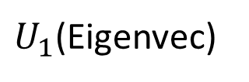
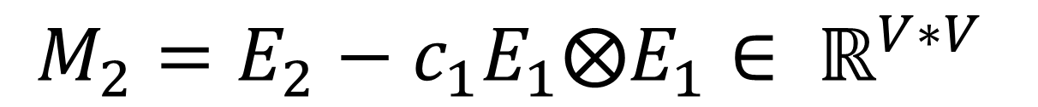



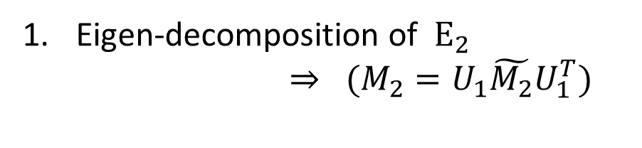
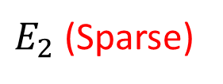

Speedup 1
Eigen-Decomposition of $M_{2}$
$$M_{2}=E_{2}−c_{1}E_{1}⨂E_{1}∈ ℝ^{V∗V}$$
Eigen-decomposition of $E_{2}$
$⇒ (M_{2}=U_{1}\tilde{M_{2}}U_{1}^{T})$
$Σ_{1}−c_{1}\left(U_{1}^{T}E_{1}\right)⊗{(U}_{1}^{T}E_{1})$
$E_{2}$ (Sparse)
$U_{1}$(Eigenvec)
AB: 0.001
BC: 0.002
AC: 0.003
:
$$Σ_{1}$$
$$U_{1}^{T}$$
V
V
V
k
k
V
k
k

Slide 39
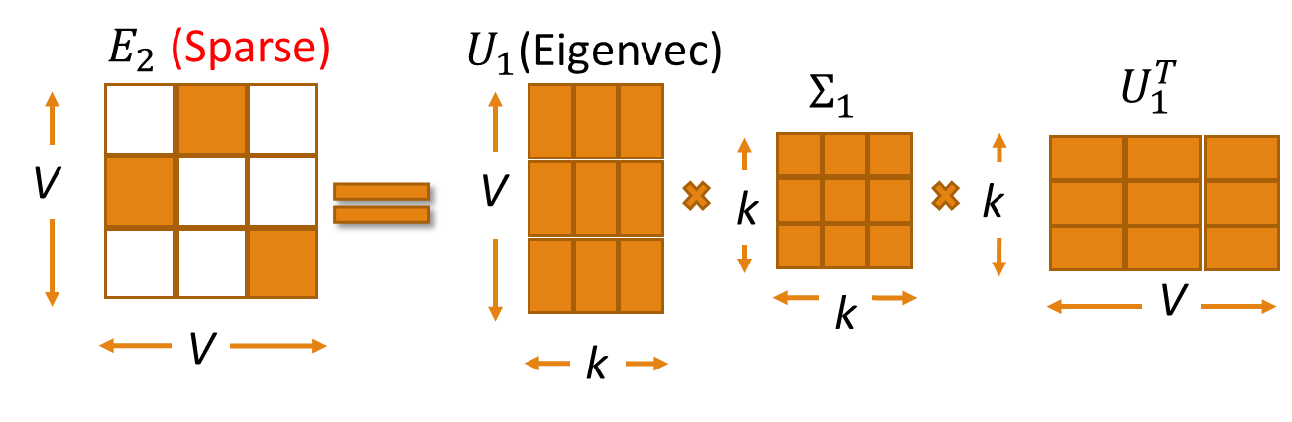

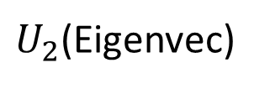

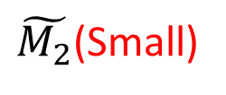
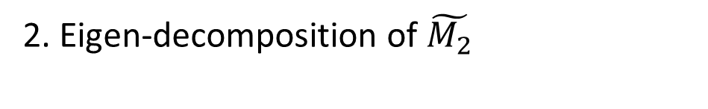
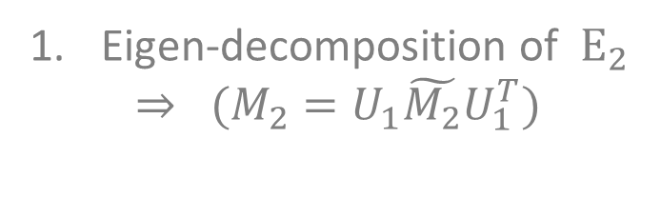
Speedup 1
Eigen-Decomposition of $M_{2}$
$$M_{2}=\left(U_{1}U_{2}\right)Σ{\left(U_{1}U_{2}\right)}^{T}\text{=}\text{M}ΣM^{T}$$
Eigen-decomposition of $E_{2}$
$$⇒ (M_{2}=U_{1}\tilde{M_{2}}U_{1}^{T})$$
2. Eigen-decomposition of $\tilde{M_{2}}$
$\tilde{M_{2}}$(Small)
$U_{2}$(Eigenvec)
$$Σ_{}$$
$$U_{2}^{T}$$
k
k
k
k
k
k
k
k

Slide 40


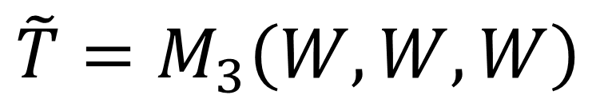

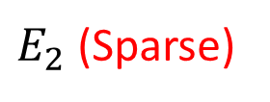
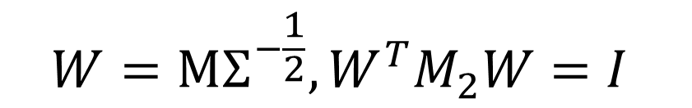
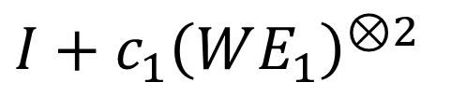




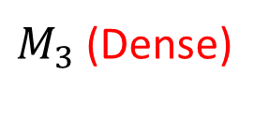

Speedup 2
Construction of Small Tensor
$$\tilde{T}=M_{3}\left(W,W,W\right)$$
$$W=\text{M}Σ^{−\frac{1}{2}}, W^{T}M_{2}W=I$$
$M_{3}$ (Dense)
$E_{2}$ (Sparse)
$$v$$
$$⊗$$
$$…$$
$$V$$
$$⊗$$
V
V
$$v$$
$$V$$
$$v$$
V
V
V
$\left(v^{⊗3}\right)\left(W,W,W\right)={\left(W^{T}v\right)}^{⊗3}$
$$I+c_{1}{\left(WE_{1}\right)}^{⊗2}$$
$$\left(v⊗E_{2}\right)\left(W,W,W\right)=W^{T}v ⊗W^{T}E_{2}W$$

Slide 41
20-3000 Times Faster
STOD – Scalable tensor orthogonal decomposition
TOD – Tensor orthogonal decomposition
Gibbs Sampling – Collapsed Gibbs sampling
Two scans vs. thousands of scans
Synthetic data
Real data
L=19M
L=39M
Notes:
STROD is much more scalable than existing algorithms
STROD is much more scalable than TROD, TROD_2 and TROD_3

Slide 42
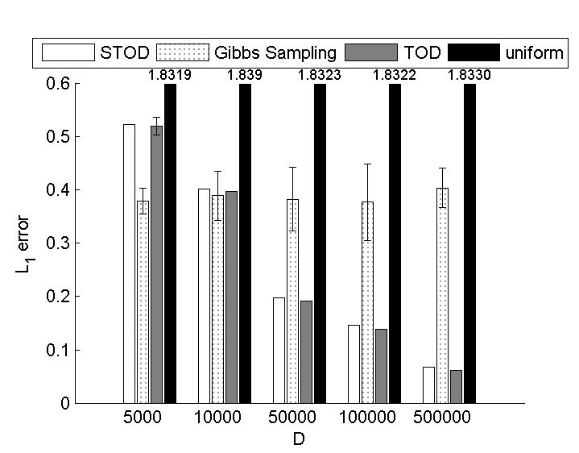
Effectiveness
STOD = TOD > Gibbs Sampling
Recovery error on synthetic data
Coherence on real data
Recovery error is low when the sample is large enough
Variance is almost 0
Coherence is high
CS
News
Notes:
STROD is much more scalable than existing algorithms
STROD is much more scalable than TROD, TROD_2 and TROD_3

Slide 43
Summary of LDA Model Inference
Maximum likelihood
Method of Moments
Approximate inference
  slow, scan data thousands of times
  large variance, no theoretic guarantee
Numerous follow-up work
  further approximation [Porteous et al. 08, Yao et al. 09, Hoffman et al. 12] etc.
  parallelization [Newman et al. 09] etc.
  online learning [Hoffman et al. 13] etc.
STOD [Wang et al. 14a]
  fast, scan data twice
  robust recovery with theoretic guarantee
New and promising!

Slide 44
Methodologies of Topic Mining
A. Traditional bag-of-words topic modeling
B. Extension of topic modeling
i) Flat -> hierarchical
ii) Unigrams -> phrases
iii) Text -> text + entity
C. An integrated framework

Slide 45
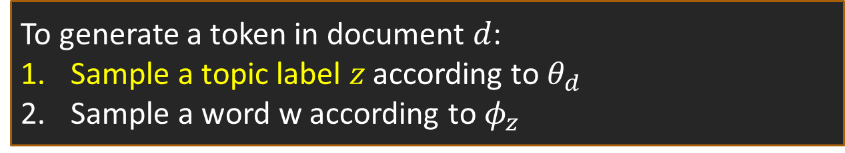
Flat Topics -> Hierarchical Topics
In PLSA and LDA, a topic is selected from a flat pool of topics
In hierarchical topic models, a topic is selected from a hierarchy
CS
o
Topic $φ_{1}$
Topic $φ_{k}$
…
Information technology & system
government 0.3
response 0.2
...
donate 0.1
relief 0.05
...
o/1
o/2
IR
o/1/1
o/1/2
o/2/1
o/2/2
DB
To generate a token in document $d$:
Sample a topic label $z$ according to $θ_{d}$
Sample a word w according to $φ_{z}$
.4
.3
.3
Topic $φ_{z}$

Slide 46
Hierarchical Topic Models
Topics form a tree structure
  nested Chinese Restaurant Process [Griffiths et al. 04]
  recursive Chinese Restaurant Process [Kim et al. 12a]
  LDA with Topic Tree [Wang et al. 14b]
Topics form a DAG structure
  Pachinko Allocation [Li & McCallum 06]
  hierarchical Pachinko Allocation [Mimno et al. 07]
  nested Chinese Restaurant Franchise [Ahmed et al. 13]
o
o/1
o/2
o/1/1
o/1/2
o/2/1
o/2/2
o
o/1
o/2
o/1/1
o/1/2
o/2/1
o/2/2

Slide 47
Hierarchical Topic Model Inference
Maximum likelihood
Method of Moments
Exact inference is intractable
Approximate inference: variational inference or MCMC
Non recursive – all the topics are inferred at once
Scalable Tensor Recursive Orthogonal Decomposition [Wang et al. 14b]
  fast and robust recovery with theoretic guarantee
Recursive method - only for LDA with Topic Tree model
Most popular

Slide 48










LDA with Topic Tree
$$α_{o}$$
o
$$α_{o/1}$$
o/1
o/2
$$φ_{o/1/1}$$
$$φ_{o/1/2}$$
o/1/1
o/1/2
o/2/1
o/2/2
Topic distributions
$$α$$
$$θ$$
$$z_{1}$$
…
$$z_{h}$$
$$w$$
$$φ$$
Word distributions
Dirichlet prior
#words in d
#docs
Latent Dirichlet Allocation with Topic Tree

Slide 49
Recursive Inference for
LDA with Topic Tree
A large tree subsumes a smaller tree with shared model parameters
Flexible to decide when to terminate
Inference order
Easy to revise the tree structure

Slide 50



Scalable Tensor Recursive Orthogonal Decomposition
Input corpus
Topic $φ_{t/1}$
+ Topic t
government 0.3
response 0.2
...
Normalized pattern counts for t
A: 0.03 | AB: 0.001 | ABC: 0.001
B: 0.01 | BC: 0.002 | ABD: 0.005
C: 0.04 | AC: 0.003 | BCD: 0.004
: | : | :
k
…
k
k
$$\tilde{T}(t)$$
Topic $φ_{t/k}$
Theorem. STROD ensures robust recovery and revision
donate 0.1
relief 0.05
...

Slide 51
Methodologies of Topic Mining
A. Traditional bag-of-words topic modeling
B. Extension of topic modeling
i) Flat -> hierarchical
ii) Unigrams -> phrases
iii) Text -> text + entity
C. An integrated framework

Slide 52
Unigrams -> N-Grams
Motivation: unigrams can be difficult to interpret
learning
reinforcement
support
machine
vector
selection
feature
random
:
learning
support vector machines
reinforcement learning
feature selection
conditional random fields
classification
decision trees
:
versus
The topic that represents the area of Machine Learning

Slide 53
Various Strategies
Strategy 1: generate bag-of-words -> generate sequence of tokens
  Bigram topical model [Wallach 06], topical n-gram model [Wang et al. 07], phrase discovering topic model [Lindsey et al. 12]
Strategy 2: post bag-of-words model inference, visualize topics with n-grams
  Label topic [Mei et al. 07], TurboTopic [Blei & Lafferty 09], KERT [Danilevsky et al. 14]
Strategy 3: prior bag-of-words model inference, mine phrases and impose to the bag-of-words model
  Frequent pattern-enriched topic model [Kim et al. 12b], ToPMine [El-kishky et al. 14]

Slide 54
Strategy 1 – Simultaneously Inferring Phrases and Topic
Bigram Topic Model [Wallach 06] – probabilistic generative model that conditions on previous word and topic when drawing next word
Topical N-Grams [Wang et al. 07] – probabilistic model that generates words in textual order . Creates n-grams by concatenating successive bigrams (Generalization of Bigram Topic Model)
Phrase-Discovering LDA (PDLDA) [Lindsey et al. 12] – Viewing each sentence as a time-series of words, PDLDA posits that the generative parameter (topic) changes periodically. Each word is drawn based on previous m words (context) and current phrase topic

Slide 55
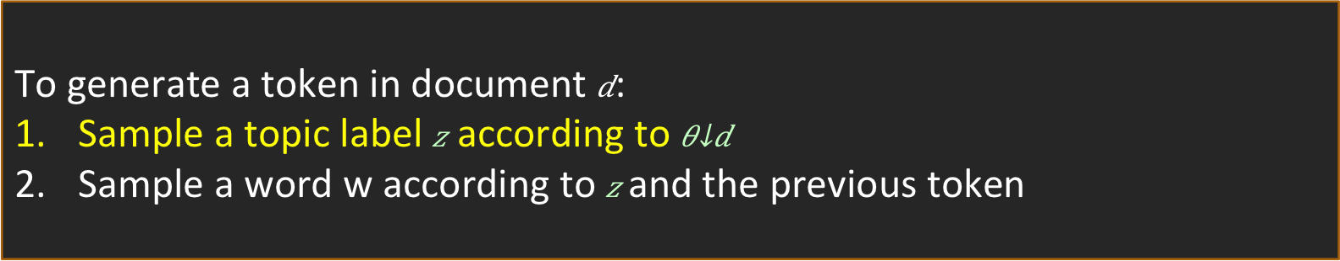
Strategy 1 – Bigram Topic Model
To generate a token in document :
Sample a topic label according to
Sample a word w according to and the previous token
Overall quality of inferred topics is improved by considering bigram statistics and word order
Interpretability of bigrams is not considered
Better quality topic model
All consecutive bigrams generated
Fast inference

Slide 56
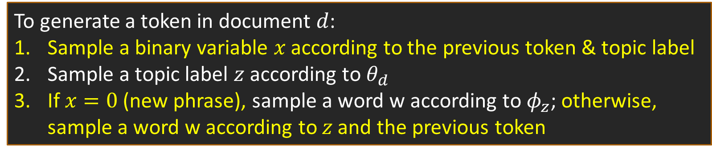
Strategy 1 – Topical N-Grams Model (TNG)
[white
0
[white]
0
d₁
house]
1
…
d_{D}
[black
0
[reports
0
color]
1
z
x
z
x
To generate a token in document $d$:
Sample a binary variable $x$ according to the previous token & topic label
Sample a topic label $z$ according to $θ_{d}$
If $x=0$ (new phrase), sample a word w according to $φ_{z}$; otherwise, sample a word w according to $z$ and the previous token
High model complexity - overfitting
Words in phrase do not share topic
High inference cost - slow

Slide 57
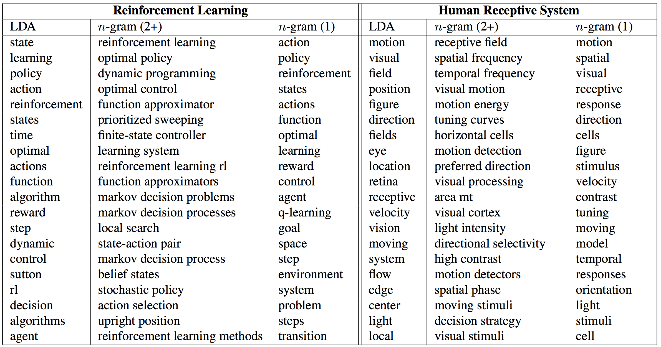
TNG: Experiments on Research Papers
Notes:
An interesting comparison
A state of the art phrase-discovering topic model

Slide 58
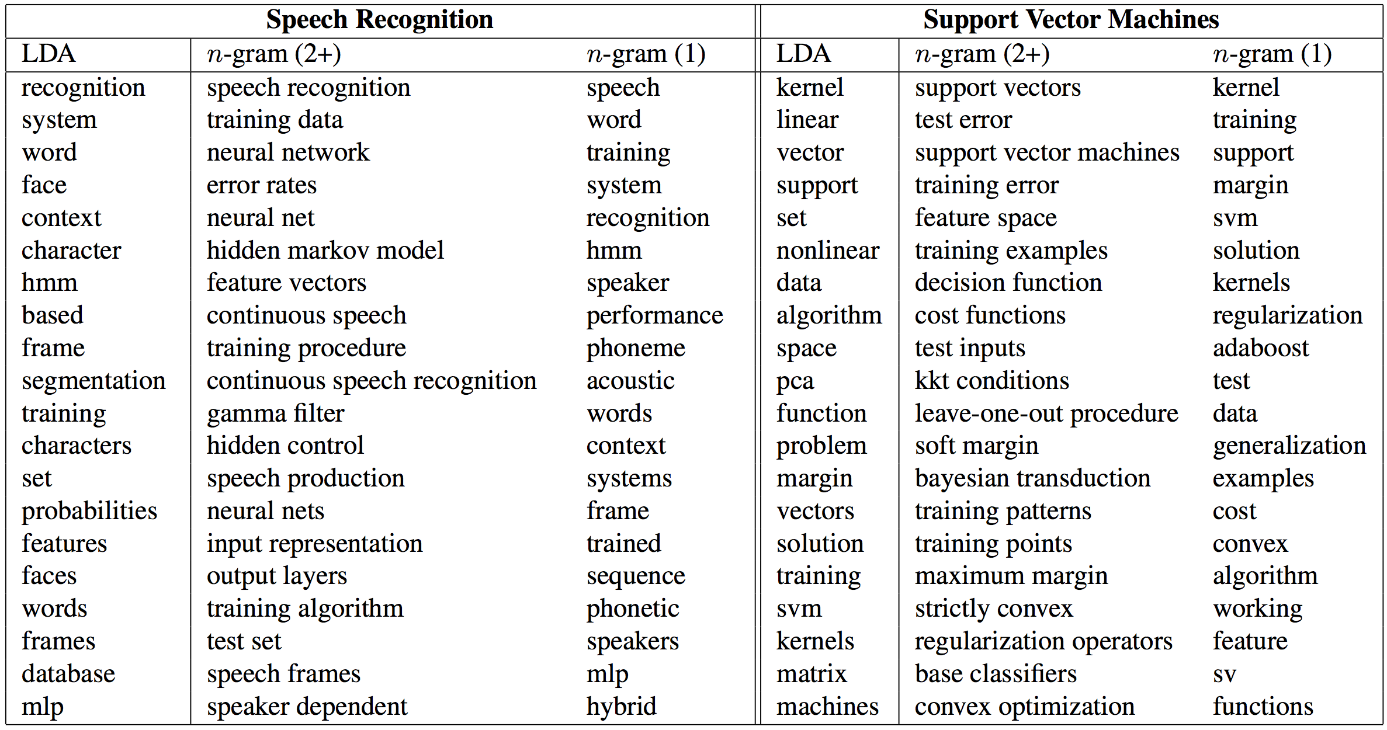
TNG: Experiments on Research Papers
Notes:
An interesting comparison
A state of the art phrase-discovering topic model

Slide 59
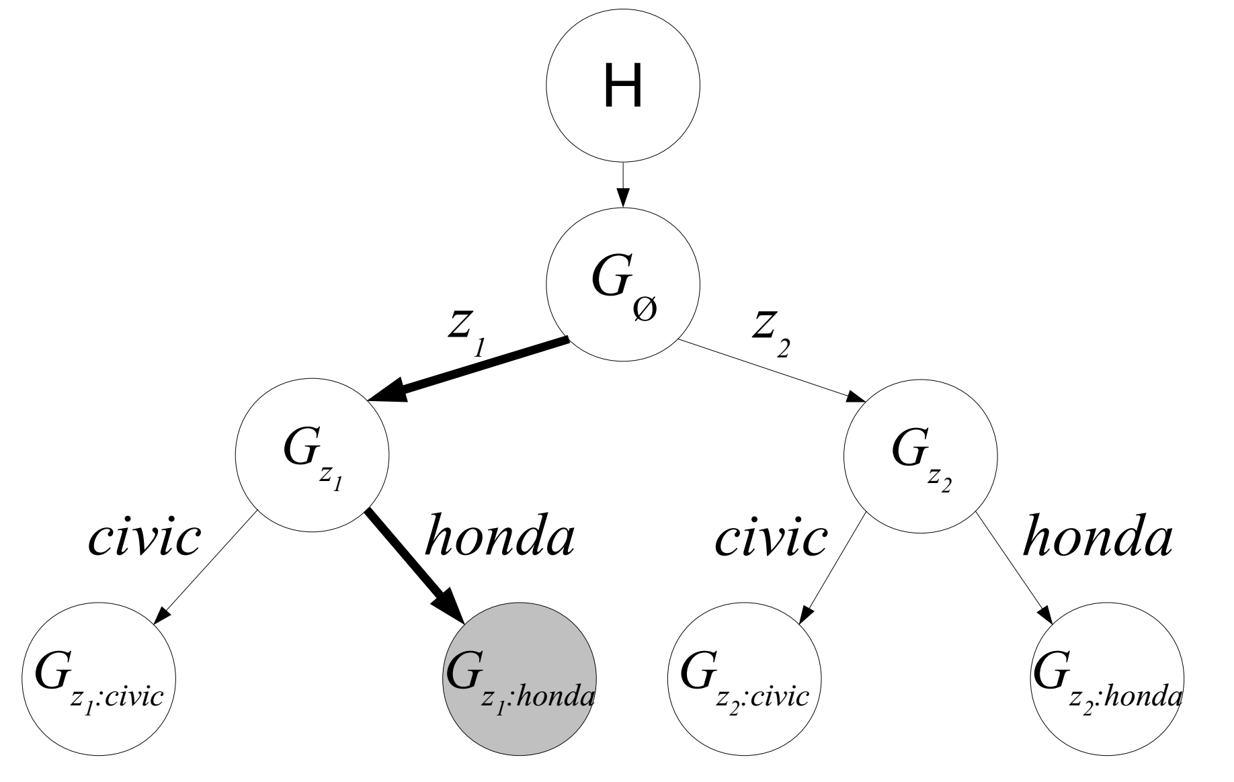
Strategy 1 – Phrase Discovering Latent Dirichlet Allocation
To generate a token in a document:
Let u, a context vector consisting of the shared phrase topic and the past m words.
Draw a token from the Pitman-Yor Process conditioned on u
When m = 1, this generative model is equivalent to TNG
High model complexity - overfitting
Principled topic assignment
High inference cost - slow

Slide 60
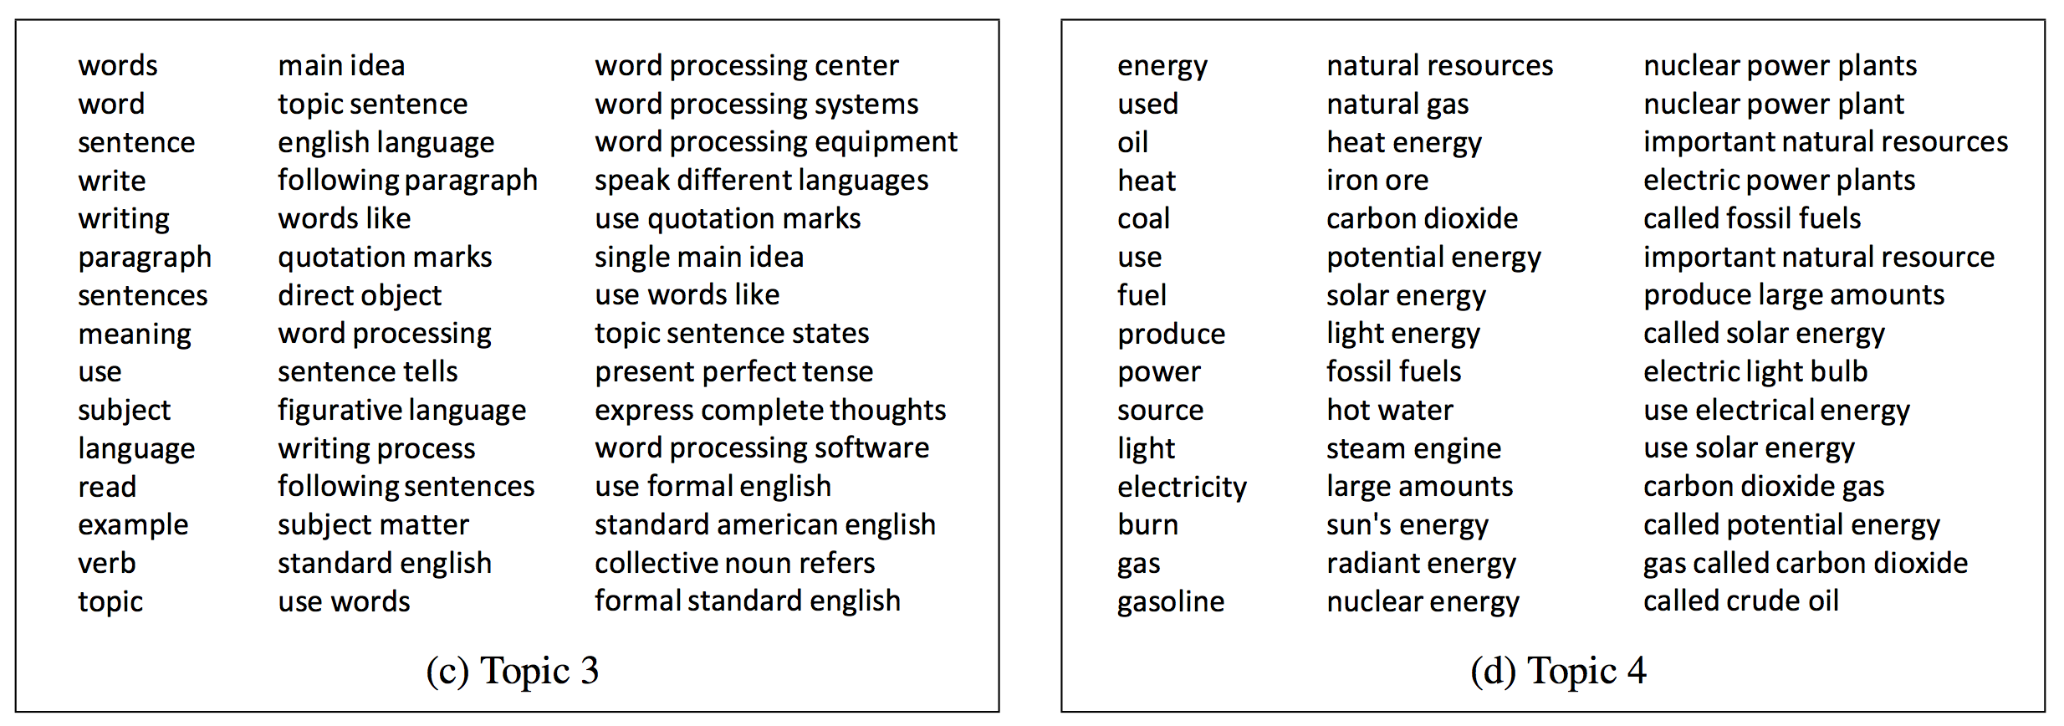
PD-LDA: Experiments on the Touchstone Applied Science Associates (TASA) corpus
Notes:
An interesting comparison
A state of the art phrase-discovering topic model

Slide 61

PD-LDA: Experiments on the Touchstone Applied Science Associates (TASA) corpus
Notes:
An interesting comparison
A state of the art phrase-discovering topic model

Slide 62
Strategy 2 – Post topic modeling phrase construction
TurboTopics [Blei & Lafferty 09] – Phrase construction as a post-processing step to Latent Dirichlet Allocation
  Merges adjacent unigrams with same topic label if merge significant.
KERT [Danilevsky et al] – Phrase construction as a post-processing step to Latent Dirichlet Allocation
  Performs frequent pattern mining on each topic
  Performs phrase ranking on four different criterion

Slide 63

Strategy 2 – TurboTopics

Slide 64
Strategy 2 – TurboTopics
TurboTopics methodology:
Perform Latent Dirichlet Allocation on corpus to assign each token a topic label
For each topic find adjacent unigrams that share the same latent topic, then perform a distribution-free permutation test on arbitrary-length back-off model.
End recursive merging when all significant adjacent unigrams have been merged.
Simple topic model (LDA)
Words in phrase share topic
Distribution-free permutation tests

Slide 65
Strategy 2 – Topical Keyphrase Extraction & Ranking (KERT)
knowledge discovery using least squares support vector machine classifiers
support vectors for reinforcement learning
a hybrid approach to feature selection
pseudo conditional random fields
automatic web page classification in a dynamic and hierarchical way
inverse time dependency in convex regularized learning
postprocessing decision trees to extract actionable knowledge
variance minimization least squares support vector machines
…
learning
support vector machines
reinforcement learning
feature selection
conditional random fields
classification
decision trees
:
Topical keyphrase
extraction & ranking
Unigram topic assignment: Topic 1 & Topic 2

Slide 66
Framework of KERT
Run bag-of-words model inference, and assign topic label to each token
Extract candidate keyphrases within each topic
Rank the keyphrases in each topic
  Popularity: ‘information retrieval’ vs. ‘cross-language information retrieval’
  Discriminativeness: only frequent in documents about topic t
  Concordance: ‘active learning’ vs.‘learning classification’
  Completeness: ‘vector machine’ vs. ‘support vector machine’
Frequent pattern mining
Comparability property: directly compare phrases of mixed lengths

Slide 67
Comparison of phrase ranking methods
kpRel [Zhao et al. 11] | KERT (-popularity) | KERT (-discriminativeness) | KERT (-concordance) | KERT [Danilevsky et al. 14]
learning | effective | support vector machines | learning | learning
classification | text | feature selection | classification | support vector machines
selection | probabilistic | reinforcement learning | selection | reinforcement learning
models | identification | conditional random fields | feature | feature selection
algorithm | mapping | constraint satisfaction | decision | conditional random fields
features | task | decision trees | bayesian | classification
decision | planning | dimensionality reduction | trees | decision trees
: | : | : | : | :
The topic that represents the area of Machine Learning

Slide 68
Strategy 3 – Phrase Mining + Topic Modeling
TopMine [El-Kishky et al 14] – Performs phrase construction, then topic mining.
ToPMine framework:
Perform frequent contiguous pattern mining to extract candidate phrases and their counts
Perform agglomerative merging of adjacent unigrams as guided by a significance score. This segments each document into a “bag-of-phrases”
The newly formed bag-of-phrases are passed as input to PhraseLDA, an extension of LDA that constrains all words in a phrase to each share the same latent topic.

Slide 69
Strategy 3 – Phrase Mining + Topic Model (ToPMine)
Strategy 2: the tokens in the same phrase may be assigned to different topics
knowledge discovery using least squares support vector machine classifiers…
Knowledge discovery and support vector machine should have coherent topic labels
Solution: switch the order of phrase mining and topic model inference
[knowledge discovery] using [least squares] [support vector machine] [classifiers] …
[knowledge discovery] using [least squares] [support vector machine] [classifiers] …
Phrase mining and document segmentation
Topic model inference with phrase constraints
More challenging than in strategy 2!

Slide 70



Phrase Mining: Frequent Pattern Mining + Statistical Analysis
Significance score
[Church et al. 91]
$$α(A,B)=\frac{|AB|−|A||B|/n}{\sqrt{\left|AB\right|}}$$
Good Phrases
Notes:
To test which to consecutive phrases should be merged. In this way we can correctly estimate the frequency of each phrase without double counting. And then it’s easy to prune bad phrases
Explain equation
Turbo Topic: 50 days
Our method: 5 mins

Slide 71

Phrase Mining: Frequent Pattern Mining + Statistical Analysis
Significance score
[Church et al. 91]
$$α(A,B)=\frac{|AB|−|A||B|/n}{\sqrt{\left|AB\right|}}$$
[Markov blanket] [feature selection] for [support vector machines]
[knowledge discovery] using [least squares] [support vector machine] [classifiers]
…[support vector] for [machine learning]…
[support vector machine]: | 90 | 80
[vector machine]: | 95 | 0
[support vector]: | 100 | 20
Raw freq
True freq
Notes:
To test which to consecutive phrases should be merged. In this way we can correctly estimate the frequency of each phrase without double counting. And then it’s easy to prune bad phrases
Explain equation
Turbo Topic: 50 days
Our method: 5 mins

Slide 72



Collocation Mining
A collocation is a sequence of words that occur more frequently than is expected. These collocations can often be quite “interesting” and due to their non-compositionality, often relay information not portrayed by their constituent terms (e.g., “made an exception”, “strong tea”)
There are many different measures used to extract collocations from a corpus [Ted Dunning 93, Ted Pederson 96]
  mutual information, t-test, z-test, chi-squared test, likelihood ratio
Many of these measures can be used to guide the agglomerative phrase-segmentation algorithm

Slide 73

ToPMine: Phrase LDA (Constrained Topic Modeling)
Generative model for PhraseLDA is the same as LDA.
The model incorporates constraints obtained from the “bag-of-phrases” input
  Chain-graph shows that all words in a phrase are constrained to take on the same topic values
[knowledge discovery] using [least squares] [support vector machine] [classifiers] …
Topic model inference with phrase constraints

Slide 74
Example Topical Phrases
PDLDA [Lindsey et al. 12] – Strategy 1 (3.72 hours)
ToPMine [El-kishky et al. 14] – Strategy 3 (67 seconds)
social networks | information retrieval
web search | text classification
time series | machine learning
search engine | support vector machines
management system | information extraction
real time | neural networks
decision trees | text categorization
: | :
Topic 1 | Topic 2
information retrieval | feature selection
social networks | machine learning
web search | semi supervised
search engine | large scale
information extraction | support vector machines
question answering | active learning
web pages | face recognition
: | :
Topic 1 | Topic 2
Notes:
An interesting comparison
A state of the art phrase-discovering topic model

Slide 75

ToPMine: Experiments on DBLP Abstracts
Notes:
An interesting comparison
A state of the art phrase-discovering topic model

Slide 76

ToPMine: Experiments on Associate Press News (1989)
Notes:
An interesting comparison
A state of the art phrase-discovering topic model

Slide 77


ToPMine: Experiments on Yelp Reviews
Notes:
An interesting comparison
A state of the art phrase-discovering topic model

Slide 78

Comparison of Strategies on Runtime
Runtime evaluation
strategy 3 > strategy 2 > strategy 1
Comparison of three strategies
Notes:
An interesting comparison
A state of the art phrase-discovering topic model

Slide 79
Comparison of Strategies on Topical Coherence
Coherence of topics
strategy 3 > strategy 2 > strategy 1
Comparison of three strategies
Notes:
An interesting comparison
A state of the art phrase-discovering topic model

Slide 80

Comparison of Strategies with Phrase Intrusion
Phrase intrusion
strategy 3 > strategy 2 > strategy 1
Comparison of three strategies
Notes:
An interesting comparison
A state of the art phrase-discovering topic model

Slide 81

Comparison of Strategies on Phrase Quality
Phrase quality
strategy 3 > strategy 2 > strategy 1
Comparison of three strategies
Notes:
An interesting comparison
A state of the art phrase-discovering topic model

Slide 82
Summary of Topical N-Gram Mining
Strategy 1: generate bag-of-words -> generate sequence of tokens
  integrated complex model; phrase quality and topic inference rely on each other
  slow and overfitting
Strategy 2: post bag-of-words model inference, visualize topics with n-grams
  phrase quality relies on topic labels for unigrams
  can be fast
  generally high-quality topics and phrases
Strategy 3: prior bag-of-words model inference, mine phrases and impose to the bag-of-words model
  topic inference relies on correct segmentation of documents, but not sensitive
  can be fast
  generally high-quality topics and phrases

Slide 83
Methodologies of Topic Mining
A. Traditional bag-of-words topic modeling
B. Extension of topic modeling
i) Flat -> hierarchical
ii) Unigrams -> phrases
iii) Text -> text + entity
C. An integrated framework

Slide 84




Text Only -> Text + Entity
Text-only corpus
Topic $φ_{1}$
Topic $φ_{k}$
Doc $θ_{1}$
.4
.3
.3
…
Criticism of government response to the hurricane …
government 0.3
response 0.2
...
donate 0.1
relief 0.05
...
…
Doc $θ_{D}$
.2
.5
.3
entity
What should be the output?
How to use linked entity information?
text

Slide 85
Three Modeling Strategies
Resemble Entities to documents
Resemble entities to words
An entity has a multinomial distribution over topics
A topic has a multinomial distribution over each type of entities
Surajit Chaudhuri
.3
.4
.3
KDD 0.3
ICDM 0.2
...
Jiawei Han 0.1
Christos Faloustos 0.05
...
Topic 1
…
SIGMOD
.2
.5
.3
Over venues
Over authors
Resemble entities to topics
SIGMOD
database 0.3
system 0.2
...
An entity has a multinomial distribution over words

Slide 86
Resemble Entities to Documents
Regularization - Linked documents or entities have similar topic distributions
  iTopicModel [Sun et al. 09a]
  TMBP-Regu [Deng et al. 11]
Use entities as additional sources of topic choices for each token
  Contextual focused topic model [Chen et al. 12] etc.
Aggregate documents linked to a common entity as a pseudo document
  Co-regularization of inferred topics under multiple views [Tang et al. 13]

Slide 87





Resemble Entities to Documents
Regularization - Linked documents or entities have similar topic distributions
  iTopicModel [Sun et al. 09a]
  TMBP-Regu [Deng et al. 11]
Doc $θ_{3}$
Doc $θ_{2}$
Doc $θ_{1}$
$θ_{2}$ should be similar to $θ_{1},θ_{3}$
$θ_{1}^{d}$ should be similar to $θ_{5}^{u},θ_{2}^{u},θ_{2}^{v}$

Slide 88



Resemble Entities to Documents
Use entities as additional sources of topic choice for each token
  Contextual focused topic model [Chen et al. 12]
To generate a token in document $d$:
Sample a variable $x$ for the context type
Sample a topic label $z$ according to $θ$ of the context type decided by $x$
Sample a word w according to $φ_{z}$
On Random Sampling over Joins
$x=1$, sample $z$ from document’s topic distribution
.4
.3
.3
$x=2$, sample $z$ from author’s topic distribution
.3
.4
.3
Surajit Chaudhuri
SIGMOD
$x=3$, sample $z$ from venue’s topic distribution
.2
.5
.3

Slide 89


Resemble Entities to Documents
Aggregate documents linked to a common entity as a pseudo document
  Co-regularization of inferred topics under multiple views [Tang et al. 13]
Document view
A single paper
Author view
Venue view
All Surajit Chaudhuri’s papers
Topic $φ_{1}$
…
Topic $φ_{k}$
All SIGMOD papers

Slide 90
Three Modeling Strategies
Resemble Entities to documents
Resemble entities to words
An entity has a multinomial distribution over topics
A topic has a multinomial distribution over each type of entities
Surajit Chaudhuri
.3
.4
.3
KDD 0.3
ICDM 0.2
...
Jiawei Han 0.1
Christos Faloustos 0.05
...
Topic 1
…
SIGMOD
.2
.5
.3
Over venues
Over authors
Resemble entities to topics
SIGMOD
database 0.3
system 0.2
...
An entity has a multinomial distribution over words

Slide 91



Resemble Entities to Topics
Entity-Topic Model (ETM) [Kim et al. 12c]
Topic $φ_{1}$
SIGMOD
Surajit Chaudhuri
…
…
data 0.3
mining 0.2
...
database 0.3
system 0.2
...
database 0.1
query 0.1
...
…
text
venue
author
To generate a token in document $d$:
Sample an entity $e$
Sample a topic label $z$ according to $θ_{d}$
Sample a word w according to $φ_{z,e}$
$$φ_{z,e}\sim Dir(w_{1}φ_{z}+w_{2}φ_{e})$$
Paper text
Surajit Chaudhuri
SIGMOD

Slide 92








Example topics learned by ETM
$$φ_{z}$$
$$φ_{z,e}$$
$$φ_{z,e}$$
$$φ_{z,e}$$
On a news dataset about Japan tsunami 2011
$$φ_{e}$$
$$φ_{z,e}$$
$$φ_{z,e}$$
$$φ_{z,e}$$

Slide 93
Three Modeling Strategies
Resemble Entities to documents
Resemble entities to words
An entity has a multinomial distribution over topics
A topic has a multinomial distribution over each type of entities
Surajit Chaudhuri
.3
.4
.3
KDD 0.3
ICDM 0.2
...
Jiawei Han 0.1
Christos Faloustos 0.05
...
Topic 1
…
SIGMOD
.2
.5
.3
Over venues
Over authors
Resemble entities to topics
SIGMOD
database 0.3
system 0.2
...
An entity has a multinomial distribution over words

Slide 94

Resemble Entities to Words
Entities as additional elements to be generated for each doc
  Conditionally independent LDA [Cohn & Hofmann 01]
  CorrLDA1 [Blei & Jordan 03]
  SwitchLDA & CorrLDA2 [Newman et al. 06]
  NetClus [Sun et al. 09b]
Topic 1
data 0.2
mining 0.1
...
Jiawei Han 0.1
Christos Faloustos 0.05
...
KDD 0.3
ICDM 0.2
...
words
authors
venues
To generate a token/entity in document $d$:
Sample a topic label $z$ according to $θ_{d}$
Sample a token w / entity e according to $φ_{z}^{}$ or $φ_{z}^{e}$

Slide 95
Comparison of Three Modeling Strategies for Text + Entity
Resemble Entities to documents
Resemble entities to words
Entities regularize textual topic discovery
Entities enrich and regularize the textual representation of topics
Surajit Chaudhuri
.3
.4
.3
# params = k*(E+V)
KDD 0.3
ICDM 0.2
...
Jiawei Han 0.1
Christos Faloustos 0.05
...
…
Topic 1
SIGMOD
.2
.5
.3
Over venues
Over authors
Resemble entities to topics
SIGMOD
database 0.3
system 0.2
...
Each entity has its own profile
# params = k*E*V

Slide 96
Methodologies of Topic Mining
A. Traditional bag-of-words topic modeling
B. Extension of topic modeling
i) Flat -> hierarchical
ii) Unigrams -> phrases
iii) Text -> text + entity
C. An integrated framework

Slide 97
An Integrated Framework
Hierarchy
How to choose & integrate?
Recursive
Non recursive
Phrase
Sequence of tokens generative model
Strategy 1
Post inference, visualize topics with n-grams
Strategy 2
Prior inference, mine phrases and impose to the bag-of-words model
Strategy 3
Resemble entities to documents
Modeling strategy 1
Resemble entities to topics
Modeling strategy 2
Resemble entities to words
Modeling strategy 3
Entity

Slide 98
An Integrated Framework
Hierarchy
Compatible & effective
Recursive
Non recursive
Phrase
Sequence of tokens generative model
Strategy 1
Post inference, visualize topics with n-grams
Strategy 2
Prior model inference, mine phrases and impose to the bag-of-words model
Strategy 3
Resemble entities to documents
Modeling strategy 1
Resemble entities to topics
Modeling strategy 2
Resemble entities to words
Modeling strategy 3
Entity

Slide 99
Construct A Topical HierarchY (CATHY)
Hierarchy + phrase + entity
entity
Output hierarchy with phrases & entities
i) Hierarchical topic discovery with entities
iii) Rank phrases & entities per topic
o
o/1
o/1/1
o/1/2
o/2
o/2/1
text
ii) Phrase mining
Input collection

Slide 100
Mining Framework – CATHY
Construct A Topical HierarchY
entity
Output hierarchy with phrases & entities
i) Hierarchical topic discovery with entities
iii) Rank phrases & entities per topic
o
o/1
o/1/1
o/1/2
o/2
o/2/1
text
ii) Phrase mining
Input collection

Slide 101






Hierarchical Topic Discovery with Text + Multi-Typed Entities [Wang et al. 13b,14c]
Every topic has a multinomial distribution over each type of entities
Topic 1
$$φ_{1}^{1}$$
$$φ_{1}^{2}$$
$$φ_{1}^{3}$$
data 0.2
mining 0.1
...
Jiawei Han 0.1
Christos Faloustos 0.05
...
KDD 0.3
ICDM 0.2
...
…
$$φ_{k}^{1}$$
Topic k
$$φ_{k}^{3}$$
$$φ_{k}^{2}$$
database 0.2
system 0.1
...
Surajit Chaudhuri 0.1
Jeff Naughton 0.05
...
SIGMOD 0.3
VLDB 0.3
...
words
authors
venues
Notes:
Surajit Chaudhuri 0.01
Divesh Srivastava 2.00E-02
Example: In a topic about database
High probability to see database, system, and query
Low probability to see speech, handwriting, animation
We want to embed the entities into the hierarchy.

Slide 102
Text and Links: Unified as Link Patterns
Computing machinery and intelligence
A.M. Turing
intelligence
computing
machinery
A.M. Turing
Notes:
To solve this new problem, we propose to a new methodology based on link patterns. We’ll extract the links from the input documents.
Links between heterogeneous types of elements: words and entities

Slide 103
Link-Weighted Heterogeneous Network
venue
A.M. Turing
intelligence
text
system
SIGMOD
author
database
word
author
venue

Slide 104


Generative Model for Link Patterns
A single link has a latent topic path z
o
o/1
Information technology & system
o/2
o/1/1
o/1/2
o/2/1
o/2/2
IR
DB
To generate a link between type $t_{1}$ and type $t_{2}$:
Sample a topic label $z$ according to $ρ$
Suppose
$t_{1}=t_{2}$ = word
Notes:
We assume each single link is associated with a latent topic path
e.g., a path for a link between query and processing is shown on the right
The number of links between two elements in a certain topic is a latent random variable
The more probable two elements are in a topic, the more links they have in that topic

Slide 105


Generative Model for Link Patterns
Topic o/1/2
database 0.2
system 0.1
...
database
To generate a link between type $t_{1}$ and type $t_{2}$:
Sample a topic label $z$ according to $ρ$
Sample the first end node $u$ according to $φ_{z}^{t_{1}}$
Suppose
$t_{1}=t_{2}$ = word
Notes:
We assume each single link is associated with a latent topic path
e.g., a path for a link between query and processing is shown on the right
The number of links between two elements in a certain topic is a latent random variable
The more probable two elements are in a topic, the more links they have in that topic

Slide 106

Generative Model for Link Patterns
Topic o/1/2
database 0.2
system 0.1
...
database
system
To generate a link between type $t_{1}$ and type $t_{2}$:
Sample a topic label $z$ according to $ρ$
Sample the first end node $u$ according to $φ_{z}^{t_{1}}$
Sample the second end node $v$ according to $φ_{z}^{t_{2}}$
Suppose
$t_{1}=t_{2}$ = word
Notes:
We assume each single link is associated with a latent topic path
e.g., a path for a link between query and processing is shown on the right
The number of links between two elements in a certain topic is a latent random variable
The more probable two elements are in a topic, the more links they have in that topic

Slide 107




Generative Model for Link Patterns
- Collapsed Model
database
5
system
$$e_{database,system}^{o/1/2\left(DB\right)}\sim$$
database
4
system
1
$$e_{database,system}^{o/1/1(IR)}\sim$$
Equivalently, we can generate # links between u and v: $e_{u,v} = e_{u,v}^{1} +⋯+e_{u,v}^{k}$, $e_{u,v}^{z} \sim Poisson (ρ_{z} φ_{z,u}^{t_{1}} φ_{z,v}^{t_{2}})$
Suppose
$t_{1}=t_{2}$ = word
Notes:
We assume each single link is associated with a latent topic path
e.g., a path for a link between query and processing is shown on the right
The number of links between two elements in a certain topic is a latent random variable
The more probable two elements are in a topic, the more links they have in that topic

Slide 108


Model Inference
Unrolled model
Collapsed model
Theorem. The solution derived from the collapsed model
⬄
EM solution of the unrolled model
$e_{i,j}^{x,y,t}∼Pois(\sum_{z}{{M^{t}θ_{x,y}ρ}_{z}φ_{z,u}^{t_{1}} φ_{z,v}^{t_{2}}})$

Slide 109

Model Inference
Unrolled model
Collapsed model
E-step. Posterior prob of latent topic for every link (Bayes rule)
M-step. Estimate model params (Sum & normalize soft counts)
$e_{i,j}^{x,y,t}∼Pois(\sum_{z}{{M^{t}θ_{x,y}ρ}_{z}φ_{z,u}^{t_{1}} φ_{z,v}^{t_{2}}})$

Slide 110






Model Inference Using
Expectation-Maximization (EM)
Topic o/1
Topic o/k
$$φ_{o/1}^{1}$$
$$φ_{o/1}^{2}$$
$$φ_{o/1}^{3}$$
…
data 0.2
mining 0.1
...
Jiawei Han 0.1
Christos Faloustos 0.05
...
KDD 0.3
ICDM 0.2
...
$$φ_{o/k}^{1}$$
$$φ_{o/k}^{2}$$
$$φ_{o/k}^{3}$$
...
...
...
E-step
M-step
+
Bayes rule
system
system
system
100
95
5
database
database
database
Sum & normalize counts
Topic o
Topic o/1
Topic o/2

Slide 111
Top-Down Recursion
+
system
system
system
100
95
5
database
database
database
Topic o
Topic o/1
Topic o/2
Topic o/1
+
system
system
system
95
65
30
database
Topic o/1/1
database
Topic o/1/2
database
Notes:
Replace the formulas with the exact formula in paper, and the optimization problem
Introduce the formulas first
Explain what theta, phi is
emphasize ‘estimate e_{i,j}^z for each edge (I,j), and use the graph with edge weight e_{I,j}^z to represent topic z’, and ‘for example, in this graph, this edge with weight 100 is split into 65 and 35, and topic o is split into topic o/1 and topic o/2’

Slide 112

Extension: Learn Link Type Importance
Different link types may have different importance in topic discovery
Introduce a link type weight $α_{x,y}$
  Original link weight $e_{i,j}^{x,y,z}→α_{x,y}e_{i,j}^{x,y,z}$
  $α>1$ – more important
  $0<α<1$ – less important
Theorem. $\text{we} \text{can} \text{assume} \text{w}\text{.}\text{l}\text{.}\text{o}\text{.}\text{g}$ $\prod_{x,y}{α_{x,y}^{n_{x,y}}}=1$
rescale
The EM solution is invariant to a constant scaleup of all the link weights
Notes:
In an extension of our model, we learn the weight of link types, instead of giving all link types equal weight. The intuitive idea is that different link types may have different importance in topic discovery. For example, when you infer the high-level topic of a paper, you can just use the conference information, right? You see our paper is published in ICDM, you can safely guess it’s a data mining paper. You don’t even need to look at the titles and authors. But if you want to know more specific topics of this paper, the other types of information is more important. So when we construct the hierarchy, we need to give different link types appropriate weight. And that weight should be learnt from the data.
So we introduce an extra variable \alpha to denote the weight, and put it in our model, and find the maximum likelihood

Slide 113
Optimal Weight
Average link weight
KL-divergence of prediction from observation
Notes:
I am skipping the details of the derivation. But I can give you some intuitive interpretation of the optimal weight. There are two factors to determine the weight. These two factors occur in the dominator, so the larger they are, the smaller the weight is. For a link type with larger average link weight, we should give it a smaller weight. Otherwise a type with very heavy links will dominate a type with light links, for example, the term will dominate the venue.
What’s the first factor? Term-term: 5; 20 average number ;
The second factor is how well a link type fits the current topic separation. In lower level of the hierarchy, the venue becomes a very useless type, and the prediction of venue links using the inferred model will be far away from the observed data. So the KL-divergence of the prediction from observation will be large, and the weight will be small; prediction value and real value’s diff

Slide 114
Learned Link Importance & Topic Coherence
Learned importance of different link types
Level | Word-word | Word-author | Author-author | Word-venue | Author-venue
1 | .2451 | .3360 | .4707 | 5.7113 | 4.5160
2 | .2548 | .7175 | .6226 | 2.9433 | 2.9852
Notes:
Venue plays the most important role in the first level of topic partition. If you see a paper published in SIGMOD or VLDB, you don’t need to read the paper to infer it’s about DB topic; if you see STOC or FOCS, you know it’s a theory topic

Slide 115
Phrase Mining
Frequent pattern mining; no NLP parsing
Statistical analysis for filtering bad phrases
i) Hierarchical topic discovery with entities
Output hierarchy with phrases & entities
iii) Rank phrases & entities per topic
o
o/1
o/1/1
o/1/2
o/2
o/2/1
text
ii) Phrase mining
Input collection
Notes:
I have talked a lot about the hierarchical topics. Now I’ll talk about a 2nd component in our framework: phrase mining. Phrase mining is important, just think about the big vs. big bird example. Again, we do not use any NLP technique. We mine phrases by finding frequent sequential patterns from the documents. A phrase a sequence of words. This is nothing new. With a sequential pattern mining algorithm we can easily find these sequences. But the new problem we solved is how to filter bad phrases. If we don’t do filtering, we may generate a lot of bad phrases

Slide 116
Examples of Mined Phrases
News
Computer science
energy department | president bush
environmental protection agency | white house
nuclear weapons | bush administration
acid rain | house and senate
nuclear power plant | members of congress
hazardous waste | defense secretary
savannah river | capital gains tax
: | :
: | :
information retrieval | feature selection
social networks | machine learning
web search | semi supervised
search engine | large scale
information extraction | support vector machines
question answering | active learning
web pages | face recognition
: | :
: | :

Slide 117
Phrase & Entity Ranking
entity
1. Hierarchical topic discovery w/ entities
Output hierarchy w/ phrases & entities
3. Rank phrases & entities per topic
o
o/1
o/1/1
o/1/2
o/2
o/2/1
Ranking criteria: popular, discriminative, concordant
text
2. Phrase mining
Input collection
Notes:
connection
Our solution: we treat each phrase as a whole unit, and propose a new measure based on its conditional probability in each topic
Our ranking has no systematic bias to phrase length

Slide 118

Phrase & Entity Ranking –
Estimate Topical Frequency
E.g.
$p\left(z=DB | query processing\right)=\frac{p\left(z=DB\right)p\left(query | z=DB\right)p\left(processing | z=DB\right)}{\sum_{t}{p\left(z=t\right)p\left(query | z=t\right)p\left(processing | z=t\right)}}$
$=\frac{θ_{DB}φ_{DB,query}φ_{DB,processing}}{\sum_{t}{θ_{t}φ_{t,query}φ_{t,processing}}}$
Pattern | Total | ML | DB | DM | IR
support vector machines | 85 | 85 | 0 | 0 | 0
query processing | 252 | 0 | 212 | 27 | 12
Hui Xiong | 72 | 0 | 0 | 66 | 6
SIGIR | 2242 | 444 | 378 | 303 | 1117
Frequent pattern mining
Estimated by Bayes rule

Slide 119


Phrase & Entity Ranking –
Ranking Function
‘Popular’ indicator of phrase or entity $A$ in topic $t$: $p\left(A | t\right)$
‘Discriminative’ indicator of phrase or entity $A$ in topic $t$: $\log{\frac{p\left(A | t\right)}{p\left(A | T\right)}}$
‘Concordance’ indicator of phrase $A$:$α(A)=\frac{|A|−E(\left|A\right|) }{std(\left|A\right|)}$
$$r_{t}\left(A\right)=p\left(A | t\right)\log{\frac{p\left(A | t\right)}{p\left(A | T\right)}}+ωp\left(A | t\right)\log{α(A)}$$
Pointwise KL-divergence
$T$: topic for comparison
Significance score used for phrase mining

Slide 120
Example topics: database & information retrieval
…
database system
query processing
concurrency control…
Divesh Srivastava Surajit Chaudhuri
Jeffrey F. Naughton…
ICDE
SIGMOD
VLDB…
information retrieval retrieval
question answering…
W. Bruce Croft James Allan
Maarten de Rijke…
SIGIR
ECIR
CIKM…
text categorization
text classification
document clustering
multi-document summarization…
……
relevance feedback
query expansion
collaborative filtering
information filtering…
……

Slide 121
Evaluation Method - Intrusion Detection
Which child topic does not belong to the given parent topic?
Extension of [Chang et al. 09]
Notes:
Randomly sample from a hierarchy, and generate questions
If users’ answers match the ones determined by a method, the quality is high

Slide 122
Phrases + Entities > Unigrams
66%
65%
Notes:
Our hierarchy has much higher quality than existing methods

Slide 123
Application: Entity & Community Profiling
SIGIR (2,432 papers)
443.8
377.7
302.7
1,117.4
ML
DB
DM
IR
support vector machines collaborative filtering
text categorization
text classification
conditional random fields
information systems
artificial intelligence
distributed information retrieval
query evaluation
event detection
large collections
similarity search
duplicate detection
large scale
information retrieval
question answering
web search
natural language document retrieval
108.9
160.3
583.0
260.0
127.3
matrix factorization
hidden markov models
maximum entropy
link analysis
non-negative matrix factorization
text categorization
text classification
document clustering
multi-document summarization
naïve bayes
information retrieval question answering relevance feedback document retrieval
ad hoc
web search
search engine
search results
world wide web
web search results
word sense disambiguation
named entity
named entity recognition domain knowledge dependency parsing
Important research areas in SIGIR conference ?
Notes:
Entity profiling, community detection and role discovery
Our method can be generally applied to datasets in many different domains such as social networks, enterprise and business documents, and healthcare, because we rely on very few assumptions about the data. If your data have only text, it can work. Only links, it can work too. If you have both text + links, it can give you very rich knowledge

Slide 124
Outline
Introduction to bringing structure to text
Mining phrase-based and entity-enriched topical hierarchies
Heterogeneous information network construction and mining
Trends and research problems

Slide 125
Heterogeneous network construction
Michael Jordan – researchers or basketball player?
What is the role of Dan Roth/SIGIR in machine learning? Who are important contributors of data mining?
What is the relation between David Blei and Michael Jordan?
Entity typing
Entity role analysis
Entity relation mining
Notes:
The goal of my study is to discover these latent structures. There are three kinds of latent structures that are important to answer people’s questions: topics, concepts and relations. Let’s look at some example.
These two questions involve both topics and concepts. Although these two terms look alike each other and they can both be used to group entities, I use them to refer to two different structures. I use concept to refer to ‘is-a’ relationship between an entity and its concept category.
Latent
Interdisciplinary research groups in UW Seattle?
Most relevant organizations with NSA?

Slide 126


Type Entities from Text
Entity typing
Top 10 active politicians regarding healthcare issues?
Influential high-tech companies in Silicon Valley?
Type | Entity | Mention
politician |  | Obama says more than 6M signed up for health care…
high-tech company |  | Apple leads in list of Silicon Valley's most-valuable brands…
Notes:
These are the motivating examples I showed you in the beginning. To answer these questions we first need to know which entities are politicians and which are high-tech companies. And we need to identify the mentions in text, e.g. news articles or web pages.
Most existing methods assume the concept-entity pairs are given by some knowledgebase, and focus on linking entity mentions to the entities in knowledgebase, using the information in the knowledgebase as reference. For example, they’ll measure the similarity of the context of this mention with the descriptive text in the Wikipedia, and match them based on the content similarity.

Slide 127


Large Scale Taxonomies
Name | Source | # types | # entities | Hierarchy
Dbpedia (v3.9) | Wikipedia infoboxes | 529 | 3M | Tree
YAGO2s | Wiki, WordNet, GeoNames | 350K | 10M | Tree
Freebase | Miscellaneous | 23K | 23M | Flat
Probase (MS.KB) | Web text | 2M | 5M | DAG
YAGO2s
Freebase

Slide 128

Type Entities in Text
Relying on knowledgebases – entity linking
  Context similarity: [Bunescu & Pascal 06] etc.
  Topical coherence: [Cucerzan 07] etc.
  Context similarity + entity popularity + topical coherence: Wikifier [Ratinov et al. 11]
  Jointly linking multiple mentions: AIDA [Hoffart et al. 11] etc.
  …

Slide 129
Limitation of Entity Linking
Low recall of knowledgebases
Sparse concept descriptors
Can we type entities without relying on knowledgebases?
Yes! Exploit the redundancy in the corpus
  Not relying on knowledgebases: targeted disambiguation of ad-hoc, homogeneous entities [Wang et al. 12]
  Partially relying on knowledgebases: mining additional evidence in the corpus for disambiguation [Li et al. 13]
82 of 900 shoe brands exist in Wiki
Michael Jordan won the best paper award

Slide 130
Targeted Disambiguation
[Wang et al. 12]
d1
Microsoft’s new operating system, Windows 8, is a PC operating system for the tablet age …
Target entities
d2
Microsoft and Apple are the developers of three of the most popular operating systems
Entity Id | Entity Name
e1 | Microsoft
e2 | Apple
e3 | HP
d3
Apple trees take four to five years to produce their first fruit…
CEO Meg Whitman said that HP is focusing on Windows 8 for its tablet strategy
d4
Audi is offering a racing version of its hottest TT model: a 380 HP, front-wheel …
d5

Slide 131
Targeted Disambiguation
d1
Microsoft’s new operating system, Windows 8, is a PC operating system for the tablet age …
Target entities
d2
Microsoft and Apple are the developers of three of the most popular operating systems
Entity Id | Entity Name
e1 | Microsoft
e2 | Apple
e3 | HP
d3
Apple trees take four to five years to produce their first fruit…
CEO Meg Whitman said that HP is focusing on Windows 8 for its tablet strategy
d4
Audi is offering a racing version of its hottest TT model: a 380 HP, front-wheel …
d5

Slide 132
Insight – Context Similarity
Microsoft’s new operating system, Windows 8, is a PC operating system for the tablet age …
Microsoft and Apple are the developers of three of the most popular operating systems
  Similar
Apple trees take four to five years to produce their first fruit…
CEO Meg Whitman said that HP is focusing on Windows 8 for its tablet strategy
Audi is offering a racing version of its hottest TT model: a 380 HP, front-wheel …

Slide 133
Insight – Context Similarity
Microsoft’s new operating system, Windows 8, is a PC operating system for the tablet age …
  Dissimilar
Microsoft and Apple are the developers of three of the most popular operating systems
Apple trees take four to five years to produce their first fruit…
CEO Meg Whitman said that HP is focusing on Windows 8 for its tablet strategy
Audi is offering a racing version of its hottest TT model: a 380 HP, front-wheel …

Slide 134
Insight – Context Similarity
Microsoft’s new operating system, Windows 8, is a PC operating system for the tablet age …
Microsoft and Apple are the developers of three of the most popular operating systems
Apple trees take four to five years to produce their first fruit…
  Dissimilar
CEO Meg Whitman said that HP is focusing on Windows 8 for its tablet strategy
Audi is offering a racing version of its hottest TT model: a 380 HP, front-wheel …

Slide 135
Insight – Leverage Homogeneity
Hypothesis: the context between two true mentions is more similar than between two false mentions across two distinct entities, as well as between a true mention and a false mention.
Caveat: the context of false mentions can be similar among themselves within an entity

Slide 136
Insight – Comention
Microsoft’s new operating system, Windows 8, is a PC operating system for the tablet age …
  High confidence
Microsoft and Apple are the developers of three of the most popular operating systems
Apple trees take four to five years to produce their first fruit…
CEO Meg Whitman said that HP is focusing on Windows 8 for its tablet strategy
Audi is offering a racing version of its hottest TT model: a 380 HP, front-wheel …

Slide 137
Insight – Leverage Homogeneity
  True
Microsoft’s new operating system, Windows 8, is a PC operating system for the tablet age …
  True
Microsoft and Apple are the developers of three of the most popular operating systems
Apple trees take four to five years to produce their first fruit…
CEO Meg Whitman said that HP is focusing on Windows 8 for its tablet strategy
Audi is offering a racing version of its hottest TT model: a 380 HP, front-wheel …

Slide 138
Insight – Leverage Homogeneity
  True
Microsoft’s new operating system, Windows 8, is a PC operating system for the tablet age …
  True
Microsoft and Apple are the developers of three of the most popular operating systems
Apple trees take four to five years to produce their first fruit…
  True
CEO Meg Whitman said that HP is focusing on Windows 8 for its tablet strategy
Audi is offering a racing version of its hottest TT model: a 380 HP, front-wheel …

Slide 139
Insight – Leverage Homogeneity
  True
Microsoft’s new operating system, Windows 8, is a PC operating system for the tablet age …
  True
Microsoft and Apple are the developers of three of the most popular operating systems
  False
Apple trees take four to five years to produce their first fruit…
  True
CEO Meg Whitman said that HP is focusing on Windows 8 for its tablet strategy
  False
Audi is offering a racing version of its hottest TT model: a 380 HP, front-wheel …

Slide 140
Entities in Topic Hierarchy
Philip S. Yu in data mining
Christos Faloutsos in data mining
111.6 papers
data mining / data streams / time series / association rules / mining patterns
67.8 papers
data mining / data streams / nearest neighbor / time series / mining patterns
21.0
35.6
33.3
16.7
16.4
20.0
time series nearest neighbor
association rules mining patterns
data streams
high dimensional data
selectivity estimation sensor networks
nearest neighbor
time warping
large graphs large datasets
Charu C. Aggarwal
Graham Cormode
S. Muthukrishnan
Philip S. Yu
Xiaolei Li
Eamonn J. Keogh
Jessica Lin
Michail Vlachos
Michael J. Passani
Matthias Renz
Jiawei Han
Ke Wang
Xifeng Yan
Bing Liu
Mohammed J. Zaki
Divesh Srivasta
Surajit Chaudhuri
Nick Koudas
Jeffrey F. Naughton
Yannis Papakonstantinou
Entity role analysis
Notes:
Philip Yu contributes work on the topics of mining frequent patterns and association rules
Christos Faloutsos is more geared towards the topic of mining large datasets and large graphs

Slide 141











Example Hidden Relations
Entity relation mining
Academic family from research publications
Social relationship from online social network
Jeff Ullman
Alumni
Colleague
Jeffrey Naughton (1987)
Surajit Chaudhuri (1991)
Joseph M. Hellerstein (1995)
Club friend

Slide 142
Mining Paradigms
Similarity search of relationships
Classify or cluster entity relationships
Slot filling

Slide 143
Similarity Search of Relationships
Input: relation instance
Output: relation instances with similar semantics
(Jeff Ullman, Surajit Chaudhuri)
(Jeffrey Naughton, Joseph M. Hellerstein)
(Jiawei Han, Chi Wang)
…
Is advisor of
(Apple, iPad)
(Microsoft, Surface)
(Amazon, Kindle)
…
Produce tablet

Slide 144
Classify or Cluster Entity Relationships
Input: relation instances with unknown relationship
Output: predicted relationship or clustered relationship
(Jeff Ullman, Surajit Chaudhuri)
Alumni
Colleague
Is advisor of
(Jeff Ullman, Hector Garcia)
Is colleague of
Club friend

Slide 145
Slot Filling
Input: relation instance with a missing element (slot)
Output: fill the slot
is advisor of (?, Surajit Chaudhuri) Jeff Ullman
produce tablet (Apple, ?) iPad
Model | Brand
S80 | ?
A10 | ?
T1460 | ?
Model | Brand
S80 | Nikon
A10 | Canon
T1460 | Benq

Slide 146
Text Patterns
Syntactic patterns
  [Bunescu & Mooney 05b]
Dependency parse tree patterns
  [Zelenko et al. 03]
  [Culotta & Sorensen 04]
  [Bunescu & Mooney 05a]
Topical patterns
  [McCallum et al. 05] etc.
The headquarters of Google are situated in Mountain View
Jane says John heads XYZ Inc.
Emails between McCallum & Padhraic Smyth

Slide 147
Dependency Rules & Constraints (Advisor-Advisee Relationship)
E.g., role transition - one cannot be advisor before graduation

Slide 148


Dependency Rules & Constraints
(Social Relationship)
Attribute-relationship
Connection-Relationship
Friends of the same relationship type share the same value for only certain attribute
The friends having different relationships are loosely connected

Slide 149
Methodologies for Dependency Modeling
Factor graph
  [Wang et al. 10, 11, 12]
  [Tang et al. 11]
Optimization framework
  [McAuley & Leskovec 12]
  [Li, Wang & Chang 14]
Graph-based ranking
  [Yakout et al. 12]

Slide 150
Methodologies for Dependency Modeling
Factor graph
  [Wang et al. 10, 11, 12]
  [Tang et al. 11]
Optimization framework
  [McAuley & Leskovec 12]
  [Li, Wang & Chang 14]
Graph-based ranking
  [Yakout et al. 12]
  Suitable for discrete variables
  Probabilistic model with general inference algorithms
  Both discrete and real variables
  Special optimization algorithm needed
  Similar to PageRank
  Suitable when the problem can be modeled as ranking on graphs

Slide 151
Mining Information Networks
Example: DBLP: A Computer Science bibliographic database
Knowledge hidden in DBLP Network | Mining Functions
Who are the leading researchers on Web search? | Ranking
Who are the peer researchers of Jure Leskovec? | Similarity Search
Whom will Christos Faloutsos collaborate with? | Relationship Prediction
Which types of relationships are most influential for an author to decide her topics? | Relation Strength Learning
How was the field of Data Mining emerged or evolving? | Network Evolution
Which authors are rather different from his/her peers in IR? | Outlier/anomaly detection

Slide 152




Similarity Search: Find Similar Objects in Networks Guided by Meta-Paths
Who are very similar to Christos Faloutsos?
Meta-Path: Meta-level description of a path between two objects
Schema of the DBLP Network
Different meta-paths lead to very different results!
Meta-Path: Author-Paper-Author (APA)
Meta-Path: Author-Paper-Venue-Paper-Author (APVPA)
Christos’s students or close collaborators
Similar reputation at similar venues

Slide 153





Similarity Search: PathSim Measure Helps Find Peer Objects in Long Tails
Jignesh Patel
  CS, Wisconsin
  Database area
  PhD: 1998
Anhai Doan
  CS, Wisconsin
  Database area
  PhD: 2002
PathSim
[Sun et al. 11]
Amol Deshpande
  CS, Maryland
  Database area
  PhD: 2004
Meta-Path: Author-Paper-Venue-Paper-Author (APVPA)
Jun Yang
  CS, Duke
  Database area
  PhD: 2001
Notes:
May replace with Jure Lescovec

Slide 154


PathPredict: Meta-Path Based Relationship Prediction
Meta path-guided prediction of links and relationships
Insight: Meta path relationships among similar typed links share similar semantics and are comparable and inferable
Bibliographic network: Co-author prediction (A—P—A)
vs.
venue
publish
publish⁻¹
mention⁻¹
write⁻¹
topic
paper
author
mention
write
contain/contain⁻¹
cite/cite⁻¹

Slide 155


Meta-Path Based
Co-authorship Prediction
Co-authorship prediction: Whether two authors start to collaborate
Co-authorship encoded in meta-path: Author-Paper-Author
Topological features encoded in meta-paths
Meta-Path
Semantic Meaning
The prediction power of each meta-path
  Derived by logistic regression

Slide 156







Heterogeneous Network Helps Personalized Recommendation
Users and items with limited feedback are connected by a variety of paths
Different users may require different models: Relationship heterogeneity makes personalized recommendation models easier to define
Collaborative filtering methods suffer from the data sparsity issue
A small set of users & items have a large number of ratings
Most users and items have a small number of ratings
# of ratings
Avatar
Aliens
Titanic
Revolutionary Road
# of users or items
Personalized recommendation with heterogeous networks [Yu et al. 14a]
Zoe Saldana
Adventure
James Cameron
Leonardo Dicaprio
Kate Winslet
Romance

Slide 157


Personalized Recommendation in Heterogeneous Networks
Datasets:
Methods to compare:
  Popularity: Recommend the most popular items to users
  Co-click: Conditional probabilities between items
  NMF: Non-negative matrix factorization on user feedback
  Hybrid-SVM: Use Rank-SVM to utilize both user feedback and information network
Winner: HeteRec personalized recommendation (HeteRec-p)

Slide 158
Outline
Introduction to bringing structure to text
Mining phrase-based and entity-enriched topical hierarchies
Heterogeneous information network construction and mining
Trends and research problems

Slide 159








Mining Latent Structures from Multiple Sources
Topical phrase mining
Entity typing
Satori
Knowledgebase
Taxonomy
Web tables
Web pages
Domain text
Social media
Social networks
…
Freebase
Annotate
Enrich
Enrich
Guide

Slide 160


Integration of NLP
& Data Mining
Topical phrase mining
Entity typing
NLP - analyzing single sentences
Data mining - analyzing big data

Slide 161


Open Problems on
Mining Latent Structures
What is the best way to organize information and interact with users?

Slide 162
Understand the Data
Coverage & Volatility
System, architecture and database
Information quality and security
Dataset
Information source
Knowledgebase
Data record
Freebase, Satori…
NYT, twitter…
Archives, samples ….
Papers, tweets…
How do we design such a multi-layer organization system?
How do we control information quality and resolve conflicts?
Utility
Notes:
What is the best way to organize dynamically growing info from heterogeneous sources with various quality?
Quality vs. update speed
The information grows fast, and the update of knowledgebase is always behind

Slide 163
Understand the People
NLP, ML, AI
HCI, Crowdsourcing, Web search, domain experts
structure
Topic
Relation
Concept
Understand & answer natural language questions
Explore latent structures with user guidance
Notes:
What is the best way to organize info for and interact with academic researchers, data analysts, general Web users?

Slide 164
References
[Wang et al. 14a] C. Wang, X. Liu, Y. Song, J. Han. Scalable Moment-based Inference for Latent Dirichlet Allocation, ECMLPKDD’14.
[Li et al. 14] R. Li, C. Wang, K. Chang. User Profiling in Ego Network: An Attribute and Relationship Type Co-profiling Approach, WWW’14.
[Danilevsky et al. 14] M. Danilevsky, C. Wang, N. Desai, X. Ren, J. Guo, J. Han. Automatic Construction and Ranking of Topical Keyphrases on Collections of Short Documents“, SDM’14.
[Wang et al. 13b] C. Wang, M. Danilevsky, J. Liu, N. Desai, H. Ji, J. Han. Constructing Topical Hierarchies in Heterogeneous Information Networks, ICDM’13.
[Wang et al. 13a] C. Wang, M. Danilevsky, N. Desai, Y. Zhang, P. Nguyen, T. Taula, and J. Han. A Phrase Mining Framework for Recursive Construction of a Topical Hierarchy, KDD’13.
[Li et al. 13] Y. Li, C. Wang, F. Han, J. Han, D. Roth, and X. Yan. Mining Evidences for Named Entity Disambiguation, KDD’13.

Slide 165
References
[Wang et al. 12a] C. Wang, K. Chakrabarti, T. Cheng, S. Chaudhuri. Targeted Disambiguation of Ad-hoc, Homogeneous Sets of Named Entities, WWW’12.
[Wang et al. 12b] C. Wang, J. Han, Q. Li, X. Li, W. Lin and H. Ji. Learning Hierarchical Relationships among Partially Ordered Objects with Heterogeneous Attributes and Links, SDM’12.
[Wang et al. 11] H. Wang, C. Wang, C. Zhai and J. Han. Learning Online Discussion Structures by Conditional Random Fields, SIGIR’11.
[Wang et al. 10] C. Wang, J. Han, Y. Jia, J. Tang, D. Zhang, Y. Yu and J. Guo. Mining Advisor-advisee Relationship from Research Publication Networks, KDD’10.
[Danilevsky et al. 13] M. Danilevsky, C. Wang, F. Tao, S. Nguyen, G. Chen, N. Desai, J. Han. AMETHYST: A System for Mining and Exploring Topical Hierarchies in Information Networks, KDD’13.

Slide 166
References
[Sun et al. 11] Y. Sun, J. Han, X. Yan, P. S. Yu, T. Wu. Pathsim: Meta path-based top-k similarity search in heterogeneous information networks, VLDB’11.
[Hofmann 99] T. Hofmann. Unsupervised learning by probabilistic latent semantic analysis, UAI’99.
[Blei et al. 03] D. M. Blei, A. Y. Ng, M. I. Jordan. Latent Dirichlet allocation, the Journal of machine Learning research, 2003.
[Griffiths & Steyvers 04] T. L. Griffiths, M. Steyvers. Finding scientific topics, Proc. of the National Academy of Sciences of USA, 2004.
[Anandkumar et al. 12] A. Anandkumar, R. Ge, D. Hsu, S. M. Kakade, M. Telgarsky. Tensor decompositions for learning latent variable models, arXiv:1210.7559, 2012.
[Porteous et al. 08] I. Porteous, D. Newman, A. Ihler, A. Asuncion, P. Smyth, M. Welling. Fast collapsed gibbs sampling for latent dirichlet allocation, KDD’08.

Slide 167
References
[Hoffman et al. 12] M. Hoffman, D. M. Blei, D. M. Mimno. Sparse stochastic inference for latent dirichlet allocation, ICML’12.
[Yao et al. 09] L. Yao, D. Mimno, A. McCallum. Efficient methods for topic model inference on streaming document collections, KDD’09.
[Newman et al. 09] D. Newman, A. Asuncion, P. Smyth, M. Welling. Distributed algorithms for topic models, Journal of Machine Learning Research, 2009.
[Hoffman et al. 13] M. Hoffman, D. Blei, C. Wang, J. Paisley. Stochastic variational inference, Journal of Machine Learning Research, 2013.
[Griffiths et al. 04] T. Griffiths, M. Jordan, J. Tenenbaum, and D. M. Blei. Hierarchical topic models and the nested chinese restaurant process, NIPS’04.
[Kim et al. 12a] J. H. Kim, D. Kim, S. Kim, and A. Oh. Modeling topic hierarchies with the recursive chinese restaurant process, CIKM’12.

Slide 168
References
[Wang et al. 14b] C. Wang, X. Liu, Y. Song, J. Han. Scalable and Robust Construction of Topical Hierarchies, arXiv: 1403.3460, 2014.
[Li & McCallum 06] W. Li, A. McCallum. Pachinko allocation: Dag-structured mixture models of topic correlations, ICML’06.
[Mimno et al. 07] D. Mimno, W. Li, A. McCallum. Mixtures of hierarchical topics with pachinko allocation, ICML’07.
[Ahmed et al. 13] A. Ahmed, L. Hong, A. Smola. Nested chinese restaurant franchise process: Applications to user tracking and document modeling, ICML’13.
[Wallach 06] H. M. Wallach. Topic modeling: beyond bag-of-words, ICML’06.
[Wang et al. 07] X. Wang, A. McCallum, X. Wei. Topical n-grams: Phrase and topic discovery, with an application to information retrieval, ICDM’07.

Slide 169
References
[Lindsey et al. 12] R. V. Lindsey, W. P. Headden, III, M. J. Stipicevic. A phrase-discovering topic model using hierarchical pitman-yor processes, EMNLP-CoNLL’12.
[Mei et al. 07] Q. Mei, X. Shen, C. Zhai. Automatic labeling of multinomial topic models, KDD’07.
[Blei & Lafferty 09] D. M. Blei, J. D. Lafferty. Visualizing Topics with Multi-Word Expressions, arXiv:0907.1013, 2009.
[Danilevsky et al. 14] M. Danilevsky, C. Wang, N. Desai, J. Guo, J. Han. Automatic construction and ranking of topical keyphrases on collections of short documents, SDM’14.
[Kim et al. 12b] H. D. Kim, D. H. Park, Y. Lu, C. Zhai. Enriching Text Representation with Frequent Pattern Mining for Probabilistic Topic Modeling, ASIST’12.
[El-kishky et al. 14] A. El-Kishky, Y. Song, C. Wang, C.R. Voss, J. Han. Scalable Topical Phrase Mining from Large Text Corpora, arXiv: 1406.6312, 2014.

Slide 170
References
[Zhao et al. 11] W. X. Zhao, J. Jiang, J. He, Y. Song, P. Achananuparp, E.-P. Lim, X. Li. Topical keyphrase extraction from twitter, HLT’11.
[Church et al. 91] K. Church, W. Gale, P. Hanks, D. Kindle. Chap 6, Using statistics in lexical analysis, 1991.
[Sun et al. 09a] Y. Sun, J. Han, J. Gao, Y. Yu. itopicmodel: Information network-integrated topic modeling, ICDM’09.
[Deng et al. 11] H. Deng, J. Han, B. Zhao, Y. Yu, C. X. Lin. Probabilistic topic models with biased propagation on heterogeneous information networks, KDD’11.
[Chen et al. 12] X. Chen, M. Zhou, L. Carin. The contextual focused topic model, KDD’12.
[Tang et al. 13] J. Tang, M. Zhang, Q. Mei. One theme in all views: modeling consensus topics in multiple contexts, KDD’13.

Slide 171
References
[Kim et al. 12c] H. Kim, Y. Sun, J. Hockenmaier, J. Han. Etm: Entity topic models for mining documents associated with entities, ICDM’12.
[Cohn & Hofmann 01] D. Cohn, T. Hofmann. The missing link-a probabilistic model of document content and hypertext connectivity, NIPS’01.
[Blei & Jordan 03] D. Blei, M. I. Jordan. Modeling annotated data, SIGIR’03.
[Newman et al. 06] D. Newman, C. Chemudugunta, P. Smyth, M. Steyvers. Statistical Entity-Topic Models, KDD’06.
[Sun et al. 09b] Y. Sun, Y. Yu, J. Han. Ranking-based clustering of heterogeneous information networks with star network schema, KDD’09.
[Chang et al. 09] J. Chang, J. Boyd-Graber, C. Wang, S. Gerrish, D.M. Blei. Reading tea leaves: How humans interpret topic models, NIPS’09.

Slide 172
References
[Bunescu & Mooney 05a] R. C. Bunescu, R. J. Mooney. A shortest path dependency kernel for relation extraction, HLT’05.
[Bunescu & Mooney 05b] R. C. Bunescu, R. J. Mooney. Subsequence kernels for relation extraction, NIPS’05.
[Zelenko et al. 03] D. Zelenko, C. Aone, A. Richardella. Kernel methods for relation extraction, Journal of Machine Learning Research, 2003.
[Culotta & Sorensen 04] A. Culotta, J. Sorensen. Dependency tree kernels for relation extraction, ACL’04.
[McCallum et al. 05] A. McCallum, A. Corrada-Emmanuel, X. Wang. Topic and role discovery in social networks, IJCAI’05.
[Leskovec et al. 10] J. Leskovec, D. Huttenlocher, J. Kleinberg. Predicting positive and negative links in online social networks, WWW’10.

Slide 173
References
[Diehl et al. 07] C. Diehl, G. Namata, L. Getoor. Relationship identification for social network discovery, AAAI’07.
[Tang et al. 11] W. Tang, H. Zhuang, J. Tang. Learning to infer social ties in large networks, ECMLPKDD’11.
[McAuley & Leskovec 12] J. McAuley, J. Leskovec. Learning to discover social circles in ego networks, NIPS’12.
[Yakout et al. 12] M. Yakout, K. Ganjam, K. Chakrabarti, S. Chaudhuri. InfoGather: Entity Augmentation and Attribute Discovery By Holistic Matching with Web Tables, SIGMOD’12.
[Koller & Friedman 09] D. Koller, N. Friedman. Probabilistic Graphical Models: Principles and Techniques, 2009.
[Bunescu & Pascal 06] R. Bunescu, M. Pasca. Using encyclopedic knowledge for named entity disambiguation, EACL’06.

Slide 174
References
[Cucerzan 07] S. Cucerzan. Large-scale named entity disambiguation based on wikipedia data, EMNLP-CoNLL’07.
[Ratinov et al. 11] L. Ratinov, D. Roth, D. Downey, M. Anderson. Local and global algorithms for disambiguation to wikipedia, ACL’11.
[Hoffart et al. 11] J. Hoffart, M. Yosef, I. Bordino, H. Furstenau, M. Pinkal, M. Spaniol, B. Taneva, S. Thater, G. Weikum. Robust disambiguation of named entities in text, EMNLP’11.
[Limaye et al. 10] G. Limaye, S. Sarawagi, S. Chakrabarti. Annotating and searching web tables using entities, types and relationships, VLDB’10.
[Venetis et al. 11] P. Venetis, A. Halevy, J. Madhavan, M. Pasca, W. Shen, F. Wu, G. Miao, C. Wu. Recovering semantics of tables on the web, VLDB’11.
[Song et al. 11] Y. Song, H. Wang, Z. Wang, H. Li, W. Chen. Short Text Conceptualization using a Probabilistic Knowledgebase, IJCAI’11.

Slide 175
References
[Pimplikar & Sarawagi 12] R. Pimplikar, S. Sarawagi. Answering table queries on the web using column keywords, VLDB’12.
[Yu et al. 14a] X. Yu, X. Ren, Y. Sun, Q. Gu, B. Sturt, U. Khandelwal, B. Norick, J. Han. Personalized Entity Recommendation: A Heterogeneous Information Network Approach, WSDM’14.
[Yu et al. 14b] D. Yu, H. Huang, T. Cassidy, H. Ji, C. Wang, S. Zhi, J. Han, C. Voss. The Wisdom of Minority: Unsupervised Slot Filling Validation based on Multi-dimensional Truth-Finding with Multi-layer Linguistic Indicators, COLING’14.
[Wang et al. 14c] C. Wang, J. Liu, N. Desai, M. Danilevsky, J. Han. Constructing Topical Hierarchies in Heterogeneous Information Networks, Knowledge and Information Systems, 2014.
[Ted Pederson 96] Pedersen, Ted. "Fishing for exactness." arXiv preprint cmp-lg/9608010 (1996).
[Ted Dunning 93] Dunning, Ted. "Accurate methods for the statistics of surprise and coincidence." Computational linguistics 19.1 (1993): 61-74.

